Slide 1
Presented to the Board of Trustees
Vienna / 26 May 2017
OSCE Academy in Bishkek

Slide 2
Mission of the OSCE Academy
“… to promote regional cooperation, conflict prevention and good governance in Central Asia through offering post-graduate education, professional trainings and intellectual exchange to the young generation of Central Asian leaders!”

Slide 3
OSCE Academy in Bishkek
(a Reminder)
Graduate education
MA in Politics & Security
MA in Economic Governance & Development
Professional trainings
Dialogue on security
Encouraging and promoting dialogue on comprehensive security
Research and publications
Publishing and distributing research and analysis outputs
Supporting critical analysis of history, politics and security
Quality MA programmes in Central Asia
Building up knowledge and skills of young professionals
Contributing to the quality of policy-makers and civil society
Providing forums for both academic and policy discussions

Slide 4
Past & Current Challenges
Immediate funding available only until July 2017
Internships outside of Central Asia suspended for students enrolled in MA programmes
Admission process for new cohort of students under threat of suspension
Invitation to new students depending on level of funding (one programme only?)

Slide 5
Emergency Measures
Reduction of staff – full implementation completed by July 1
Reduction of overhead costs – implementation of savings scheme ongoing
Close cooperation with POiB to cover extra-budgetary expenditures
New internship opportunities created in the Central Asia

Slide 6
Mid-Term Budgetary Measures
Reducing the numbers of students for the Academic Year 2017 / 2018
  If necessary: Suspension of one MA programme
Suspension of Professional Trainings & Alumni Network events
  Central Asian School of Journalism shortened to three weeks (from originally 10 weeks) funded by Deutsche Welle
Creation of co-financing models to support international internships

Slide 7
Long-Term Planning
Diversifying funding for Academy operations
Multiplying partnerships to sustain and develop professional trainings and research activities
Attracting funding from EU programmes (Erasmus+) to increase output of MA programmes and develop new educational initiatives (BA, MA, PhD)

Slide 8
Erasmus+ Funding as Long-Term Strategic Goal
Key Action 1
  Mobility of learners and staff: opportunities for students, young people, as well as for professors, teachers, trainers, staff of education institutions and civil society organisations to undertake a learning and/or professional experience in another country;
  Erasmus Mundus Joint Master Degrees: high-level integrated international study programmes delivered by consortia of higher education institutions that award full degree scholarships to the best master students worldwide;
  Erasmus+ Master Loans: higher education students from Programme Countries can apply for a loan backed by the Programme to go abroad for a full Master Degree.
Key Action 2
  Knowledge Alliances between higher education institutions and enterprises which aim to foster innovation, entrepreneurship, employability, knowledge exchange and/or multidisciplinary teaching and learning
  Capacity-building projects supporting cooperation with Partner Countries in the fields of higher education and youth. Capacity-building projects aim to support organisations/institutions and systems in their modernization and internationalization process.
Steps to be taken: Transition to ECTS; establishment of university partnerships / consortia; first applications by February 2018!

Slide 9
The OSCE Academy
Licenses and Accreditation
MA in Politics & Security
  License received in 2016 – valid until 02/2018
  Accreditation received in 2016 – valid until 09/2018
  New Licence procedure completed in 2017 with validity for unlimited period
MA in Economic Governance & Development
  License received in 2016 – validity for unlimited period
  Accreditation procedure under way for unlimited period – to be completed by 07/2017

Slide 10
OSCE Academy Programme Activities
MA in Politics & Security
  23 students graduated in December 2016
  29 students were admitted to the new academic year in September 2016

Slide 11
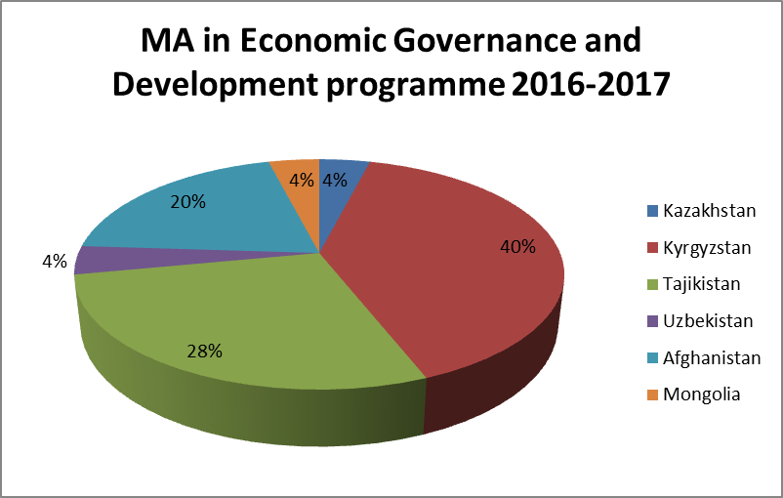
OSCE Academy Programme Activities
MA in Economic Governance & Development
  21 students graduated in December 2016
  25 students were admitted to the new academic year in September 2016

Slide 12
OSCE Academy - Admission
Admission for 2016 / 2017
  559 applications for the MA EG&D
  634 applications for the MA P&S
Admission for 2017 / 2018
  563 applications for the MA EG&D
  634 applications for the MA P&S

Slide 13
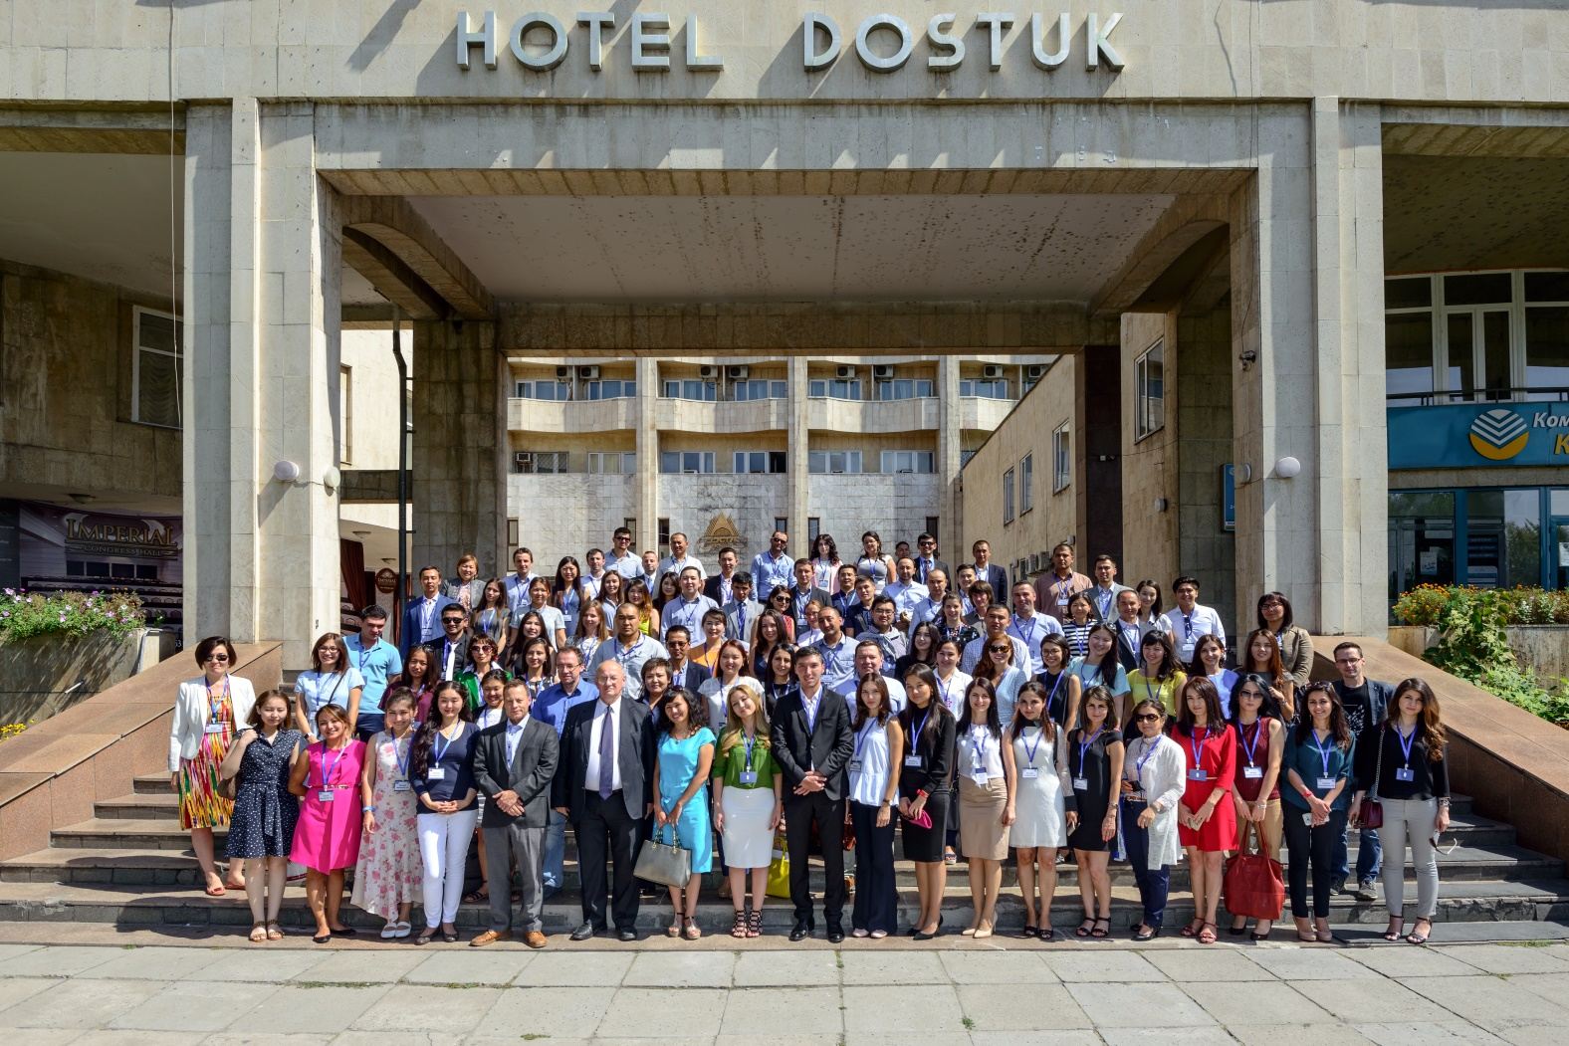
Alumni Network

Slide 14
Alumni Network
The largest Alumni Network event ever held, the 3rd Alumni Reunion, took place in September 2016 and gathered more than 90 graduates from Central Asia, Afghanistan and other countries.

Slide 15
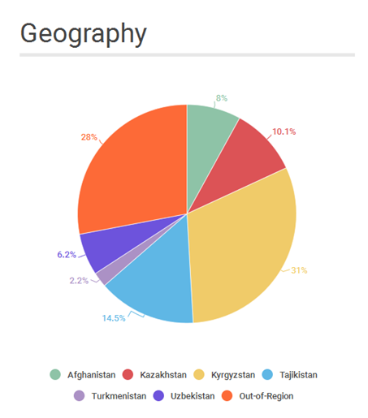
Alumni Network

Slide 16
Alumni Network

Slide 17
Alumni Network
Junior Public Officers Programme
  In Afghanistan
  In Kazakhstan
NEW Internship in the Investment Promotion Agency under the Ministry of Economy of the Kyrgyz Republic.
NEW Research Fellowship at the International Secretariat of the OSCE Parliamentary Assembly in Copenhagen.

Slide 18
Conferences in 2016
Information Security Conference “The Latest media developments in Central Asia: cooperation with civil society to enhance transparency and accountability” (28-30 March)
7th OSCE Academy-NUPI Annual Security Seminar: “Global Security Trends and Their Impact on Central Asia: 2016 And On” (1-2 September)
Conference “Post-Communism 25+: Reflections on Social, Economic & Political Transitions” (6-8 October)

Slide 19
Professional Trainings in 2016
Policy Paper Writing Seminar (18-22 April)
Regulatory Impact Analysis of Normative Acts Training (4-8 April)
Feasibility Studies for the Investment Projects Training (25-30 April)
Certificate Programme on Human Rights, Conflict Sensitivity and Project Management (11-24 June)
Central Asian School of Contemporary Journalism (June-August 2016)

Slide 20
Budget in 2016
Expenditures by Area of Activities (in EUR)
Professional Trainings | 127259
Masters Programme in Politics and Security | 304425
Masters Programme in Economic Governance and Development | 229125
Alumni Support | 40798
Dialogue and Research | 114131
General Support Costs | 224645
Total | 1040383

Slide 21
Budget in 2016
Expenditures by Source of Funding (in EUR)
Unified Budget (OSCE Centre in Bishkek) | 174297
Finland (ExB) | 23572
Germany (ExB) | 70110
USA (ExB) | 205442
Norwegian Institute of International Affairs (third-party funding) | 494436
SWISS | 72526
Total | 1040383

Slide 22
Thank You Very Much
The End

