Slide 1
Meeting of the Board of Trustees
Bishkek / Vienna (Zoom), 22.07.2020

Slide 2
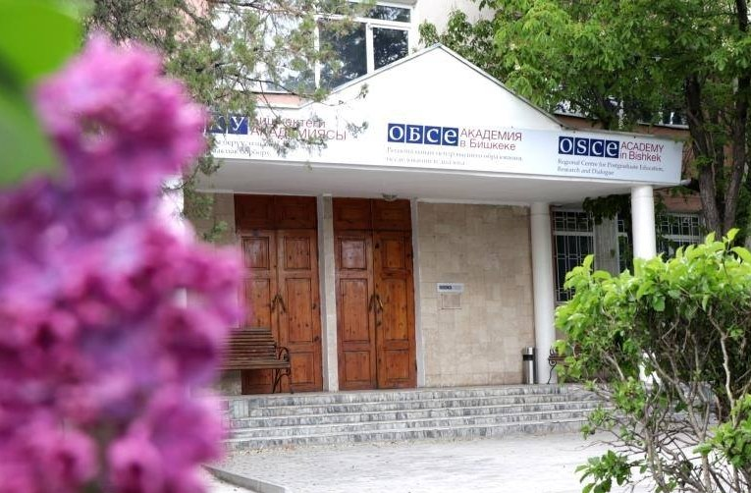
Table of Contents
Covid-19 response
Post-Graduate Education:
MA programmes (academic year 2019/2020)
MA programmes (academic year 2020/2021)
Research & Dialogue Initiatives
Research Projects
Publications
International Cooperation & Partnerships
Appendix: Budget Projections 2020 & 2021

Slide 3
Covid-19 Response
Orders of Ministry of Education and Science of the Kyrgyz Republic:
from 16.03.2020 and 24.03.2020 on distance-learning
from 19.03.2020 on faculty and admin management
By 23.03.2020 all courses of Winter semester conducted using distance-learning tools
Spring semester (May & June 2020) fully conducted online
Admission process transformed into online formats (online testing, video interviewing)
Internships planned to be conducted online
Summer School in August 2020 implemented online
Alumni Chapter meetings replaced by thematic online webinars for graduates

Slide 4
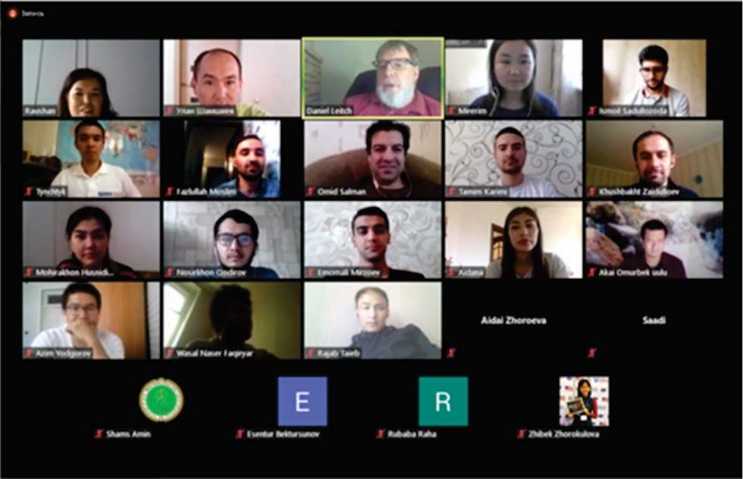
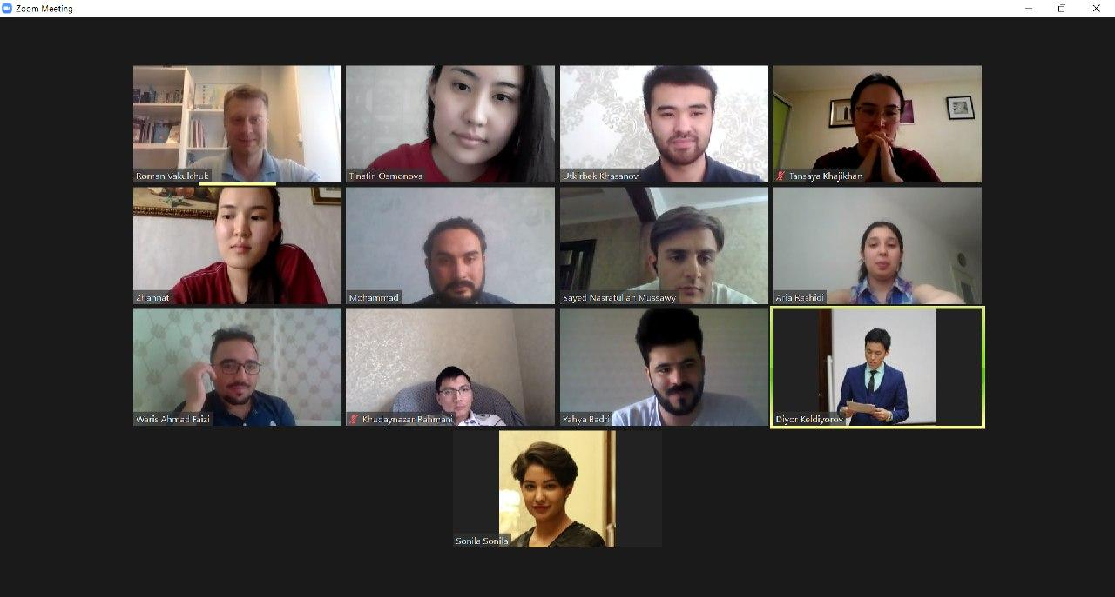
Post-Graduate Education (2019/2020)
Student Enrollment Statistics (July 2020):
Country | PS | EGD | Combined
Afghanistan | 8 | 7 | 15
Kazakhstan | 1 | 0 | 1
Kyrgyzstan | 8 | 4 | 12
Mongolia | 0 | 1 | 1
Tajikistan | 6 | 0 | 6
Turkmenistan | 0 | 0 | 0
Uzbekistan | 2 | 2 | 4
Total | 25 | 14 | 39

Slide 5
Post-Graduate Education (2019/2020)
Internship Preparations (July 2020):
International Organization / Institute | Places | Applications (1st;2nd;3rd choice) |  | Total number of applications (1st;2nd;3rd choice)
 |  | PS | EGD
OSCE Secretariat (in progress) | 6 | 2; 8; 0 | 4; 4; 0 | 6; 12; 0
NUPI (selected) | 3 | 6; 1; 1 | 4; 4; 0 | 10; 5; 1
NHC (selected) | 1 | 1; 1; 1 | - | 1; 1; 1
GCSP | tbc | 0; 1; 3 | - | 0; 1; 3
ASPR | tbc | 1; 0; 1 | 0; 1; 0 | 1; 1; 1
Aleksanteri Institute |  | 1; 0; 1 | 1; 0; 1 | 2; 0; 2
ECMI | tbc | 2; 1; 2 | - | 2; 1; 2
HCNM | tbc | 1; 2; 1 | - | 1; 2; 1
OSCE Office in Bishkek | tbc | 1; 0; 3 | 1; 0; 2 | 2; 0; 5
OSCE Office in Dushanbe | tbc | 1; 0; 0 |  | 1; 0; 0
OSCE Office in Nur-Sultan | tbc | 0; 1; 0 | 0; 0; 4 | 0; 1; 4
Internships in the region | Number of selected students
Agency - Coordinating Body for Afghan Relief and Development, Afghanistan | 2
Academy of Science of Afghanistan | 1
MA Thesis work schedule:
Activity | Dates
Submission of Thesis | 16 November 2020
Evaluation of Thesis | 17– 30 November 2020
Thesis defense | 1-4 December 2020 (tbc)

Slide 6
Post-Graduate Education (2020/2021)
Admission Statistics (from July 2020):
New in Fall Semester 2020: DAAD German Language Instructor
Country | Total submitted | Submitted |  | Shortlisted |  | Participated in tests |  | Interviewed |  | Accepted |  | Combined accepted
 |  | PS | EGD | PS | EGD | PS | EGD | PS | EGD | PS | EGD
Afghanistan | 1184 | 460 | 724 | 45 | 44 | 35 | 37 | 12 | 15 | 5 | 9 | 14
Kazakhstan | 43 | 28 | 15 | 18 | 6 | 14 | 4 | 9 | 1 | 6 | 1 | 7
Kyrgyzstan | 203 | 125 | 78 | 38 | 30 | 35 | 26 | 18 | 11 | 7 | 8 | 15
Mongolia | 7 | 5 | 2 | 3 | 1 | 2 | 1 | 1 | 1 | 0 | 1 | 1
Tajikistan | 108 | 47 | 61 | 28 | 21 | 23 | 14 | 11 | 2 | 6 | 2 | 8
Turkmenistan | 6 | 4 | 2 | 3 | 0 | 1 | 0 | 1 | 0 | 1 | 0 | 1
Uzbekistan | 37 | 16 | 21 | 9 | 6 | 7 | 4 | 3 | 4 | 2 | 2 | 4
Out of region | 28 | 20 | 8 | 10 | 0 | 7 | 0 | 4 | 0 | 3 | 0 | 3
Total | 1616 | 705 | 911 | 154 | 108 | 124 | 86 | 58 | 34 | 30 | 23 | 53

Slide 7
Research and Dialogue – Research Projects
Current Research Projects:
Horizon 2020 Grant: AGRUMIG - “Leaving something behind” – Migration Governance and Agricultural Rural Change in “home” communities; project duration 2019 - 2021;
Activities for 2020: 2-3 policy briefs on impact of COVID-19 on migration policy in KG; organising policy dialogue on migration governance
Life with Corona Project: OSCE Academy is partner of the Life with Corona project since June 2020; the project collects data on the social and economic impacts of COVID-19 (Lead: ISDC)
Danish Institute for International Studies – OSCE Academy Research Partnership: DIIS will fund several research papers to be coordinated through the OSCE Academy; the research papers (eventually published as policy briefs / collective volume) will focus on the COVID-19 crisis in Post-Soviet Central Asia

Slide 8
Research and Dialogue – Research Projects
New Research Applications:
Horizon 2020: HYDROSTAN - Hydropower in Central Asia: Demonstrating Innovative and Sustainable Solutions for Unexplored Small-scale Applications; in partnership with Trinity College Dublin; Academy planned as policy dialogue partner; submission planned for September 2020
NED Small Grants Programme: Journalism Training (Kyrgyz language) at the Academy; submitted in March 2020; grant amount: USD 50. 000
The Canada Grant for Local Initiatives: Research project planned on education; submitted in June 2020; grant amount: CAN 25 000
OSCE Transnational Threats Department (TNTD) and the Office of the Co-ordinator of OSCE Economic and Environmental Activities (OCEEA): Enhancing youth crime prevention through education on legality and awareness campaigns addressing threats of organized crime and corruption, duration: 3 years; ExB project: 2,5 million EUR

Slide 9
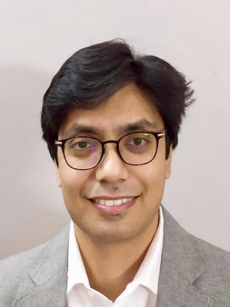
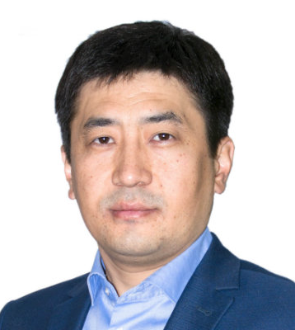
Research and Dialogue – Research Fellows
NUPI Post-Doc Fellowships, 2020-2022
Dr Rahat Sabyrbekov.
Research interests: environmental economics, ecosystem services, natural capital, and natural resource management.
Volkswagen Foundation Post-Doc Fellowship grants, 2020-2022
Dr. Aijan Sharshenova, Research Project: A Russia’s Soft Power in Kyrgyzstan: A Study of Russian Influence in Central Asia
Dr Mirza Sadaqat Huda.
Research interests: Belt and Road Initiative, renewable energy and global climate governance
Dr. Shairbek Dzhuraev, Research Project: Politics of Foreign Policy Change in Georgia and Kyrgyzstan

Slide 10
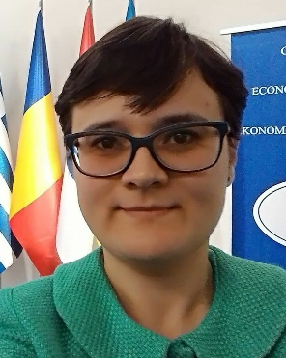
Research and Dialogue – Research Fellows
Associate Research Fellows:
Marc Jeandesboz, PhD candidate, Université de Montréal. Research Project: Post-Soviet Central Asia: at the Crossroads between Modernization and Modernities
Ana-Maria Anghelescu, PhD candidate at National University of Political Studies and Public Administration in Bucharest. Research project: Exploring the Relation between European Union and Central Asia in the Context of Increased Regional Interdependencies
Nicole Grajewski, PhD candidate, University of Oxford. Research Project: Iranian Foreign Policy in Central Asia

Slide 11
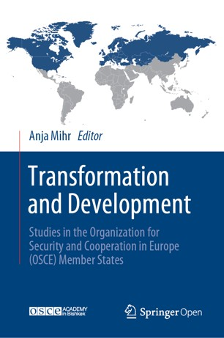
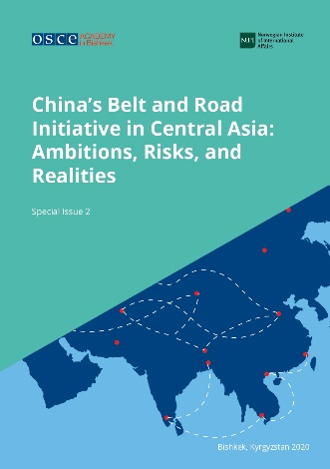
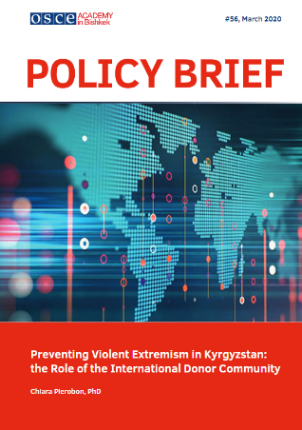
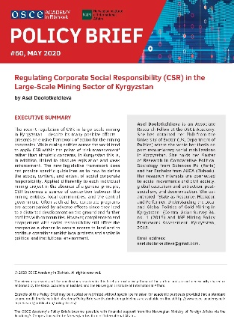
Research and Dialogue – Publications
December 2019: Alumni Magazine SalamAlum
April 2020: Anja Mihr, Transformation and Development: Studies in the Organization for Security and Cooperation in Europe (OSCE) Member States, Springer Publishers
April 2020: Special Issue #1: Migration in Kyrgyzstan (in Kyrgyz / in Russian)
May 2020: Special Issue #2: China’s Belt and Road Initiative: Ambitions, Risks and Realities
June 2020: Analytical Yearbook 2020 (in Russian)
January-May 2020: Policy Briefs #53 - #60

Slide 12
International Cooperation & Partnerships
Prolonged partnership with the OSCE PA 08.11.2019
University of Catania (Italy) 16.12.2019
Kozminski University (Poland) 06.02.2020
Middle East Technical University (METU) (Turkey) 13.02.2020
Higher School of Economics St. Petersburg (Russia) 02.04.2020
Osservatorio sull’Asia Centrale e sul Caspio (Italy) 12.06.2020
Under discussion:
European University Institute (Italy)
Russia and Eurasia Program at The Fletcher School of Law and Diplomacy at Tufts University (USA)

Slide 13
International Cooperation:
In 2020 the OSCE Academy was included in 10 applications for KA-1 (Student and Faculty mobility):
... and 1 Application KA 2 (Capacity Building in the field of Higher Education) by Salzburg University as an Associate Partner for the ‘Joint Master Political Science - Integration and Governance (PoSIG).’
Kozminski University (Poland) University of Lodz (Poland) Philipps-Universität Marburg (Germany) funding received Riga Graduate School of Law (Latvia) South East European University (North Macedonia) | National University of Political Studies and Public Administration (Romania) University of Bamberg (Germany) University of Freiburg (Germany) funding received University of Coimbra (Portugal) no funding University of Macedonia (Greece)

Slide 14
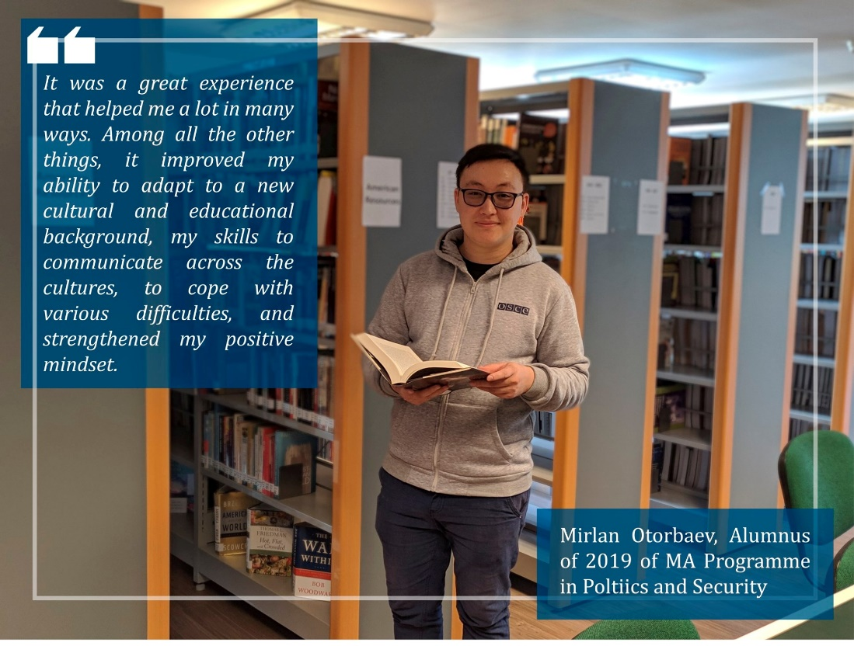
International Cooperation:
From 2019 funding for Student Mobility is received with the National University of Political Studies and Public Administration (Romania) and for Faculty Mobility with Johan Skytte Institute of Political Studies at the University of Tartu (Estonia)
1st Incoming Student 1st Outgoing Student

Slide 15
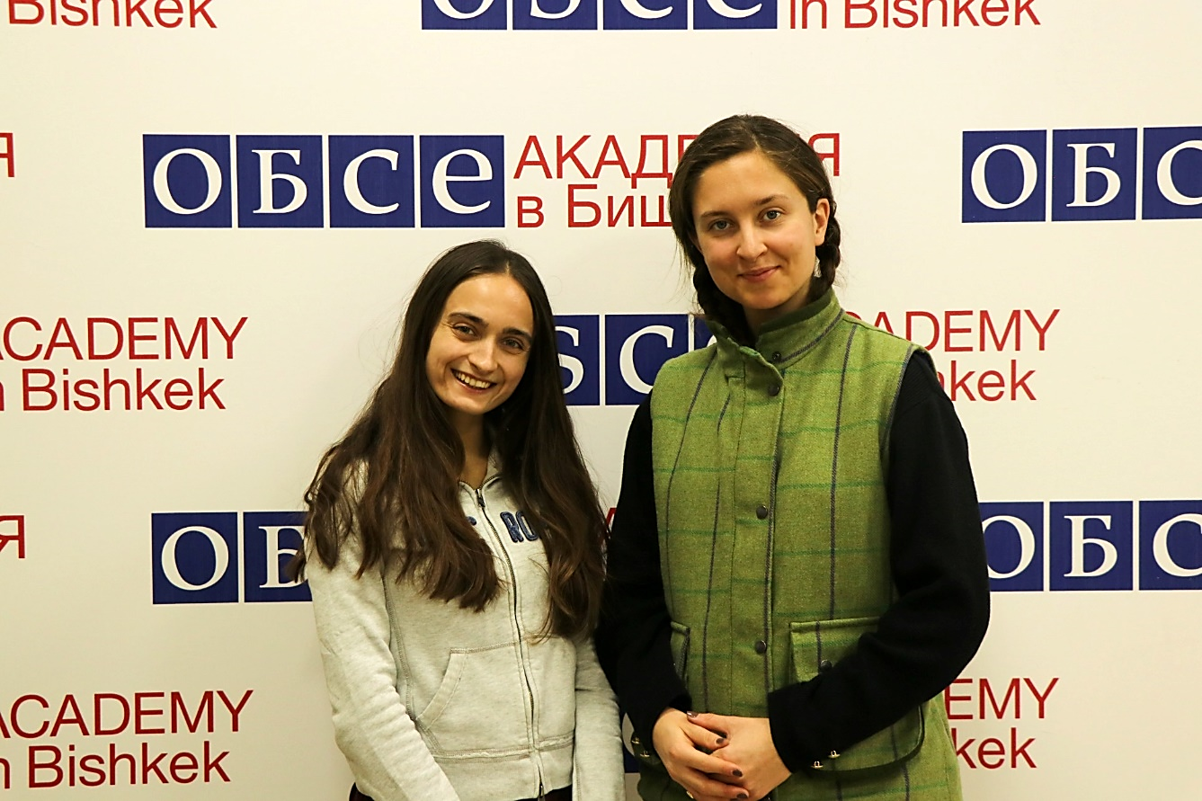
International Cooperation & Partnerships
In January 2020 the MA in Politics and Security welcomed two exchange students within the framework of the cooperation between the OSCE Academy and the European School of Political and Social Sciences, Université Catholique de Lille (France), established in September 2019
Ms. Elisa Belaz and Ms. Philippine Raphanaud

Slide 16
International Cooperation: Regional Partnerships
Higher School of Economics, KAZGUU University (Kazakhstan) 06.05.2020
GIZ in Kyrgyzstan 18.05.2020
International Ala-Too University (Kyrgyzstan) 08.11.2019
International University of Central Asia (Kyrgyzstan) 11.12.2019
Judicial General Council of Mongolia 08.07.2020
University of Central Asia (Kyrgyzstan) to be signed
Internationalisation Strategy 2020-2025: http://osce-academy.net/upload/file/IS.pdf

Slide 17
Budget Projections
2020 | UB | ExB | NOR MFA / NUPI | EU / Horizon2020 | Total:
Budget Planned | 480,000 € | 672,647 € | 533,322 € | 10,784 € | 1,696,753 €
Budget Revision | 480,000 € | 471,064 € | 533,322 € | 13,193 € | 1,465,927 €
Budget Available | 480,000 € | 439,412 € | 533,322 € | 13,193 € | 1,465,927 €
Budget Expenditures | 178,277 € | 159,221 € | 203,767 € | - € | 537,310 €
2021 | UB | ExB | NOR MFA / NUPI | EU / Horizon2020 | Total:
Budget Planned | 480,000 € | 490,450 € | 413,278 € | 15,000 € | 1,398,728 €
Budget Available | 480,000 € | (139,319 €) | 413,278 € | 15,000 € | 929,409 €

