Slide 1
Meeting of the Board of Trustees
30 October, 2019
Vienna

Slide 2
Table of Contents
Administrative Reforms
Programme Activities: Summer School & MA Programmes
Programme Activities: Admission 2020
Programme Activities: Research & Dialogue
International Cooperation and Partnerships

Slide 3
Administration
New administrative staff structure fully established. Since September 2019 Academy Management supported by four managers / heads of units:
Finance
Educational Programmes
Research & Training
International Office

Slide 4
Structural / Staff Development
Heating system renovated to prepare for upcoming Winter season
Re-allocating office rooms to free space for permanent faculty / fellows
Video Conference Equipment to be procured towards end of 2019
Staff trainings including Excel, budget & finance, First Aid,
Staff travels / participation in networking / outreach activities

Slide 5
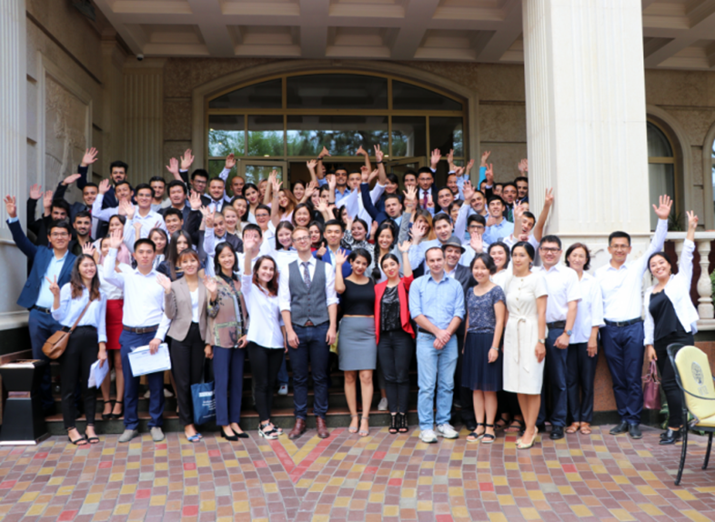
Summer School (5-31 August)

Slide 6
MA Programmes

Slide 7
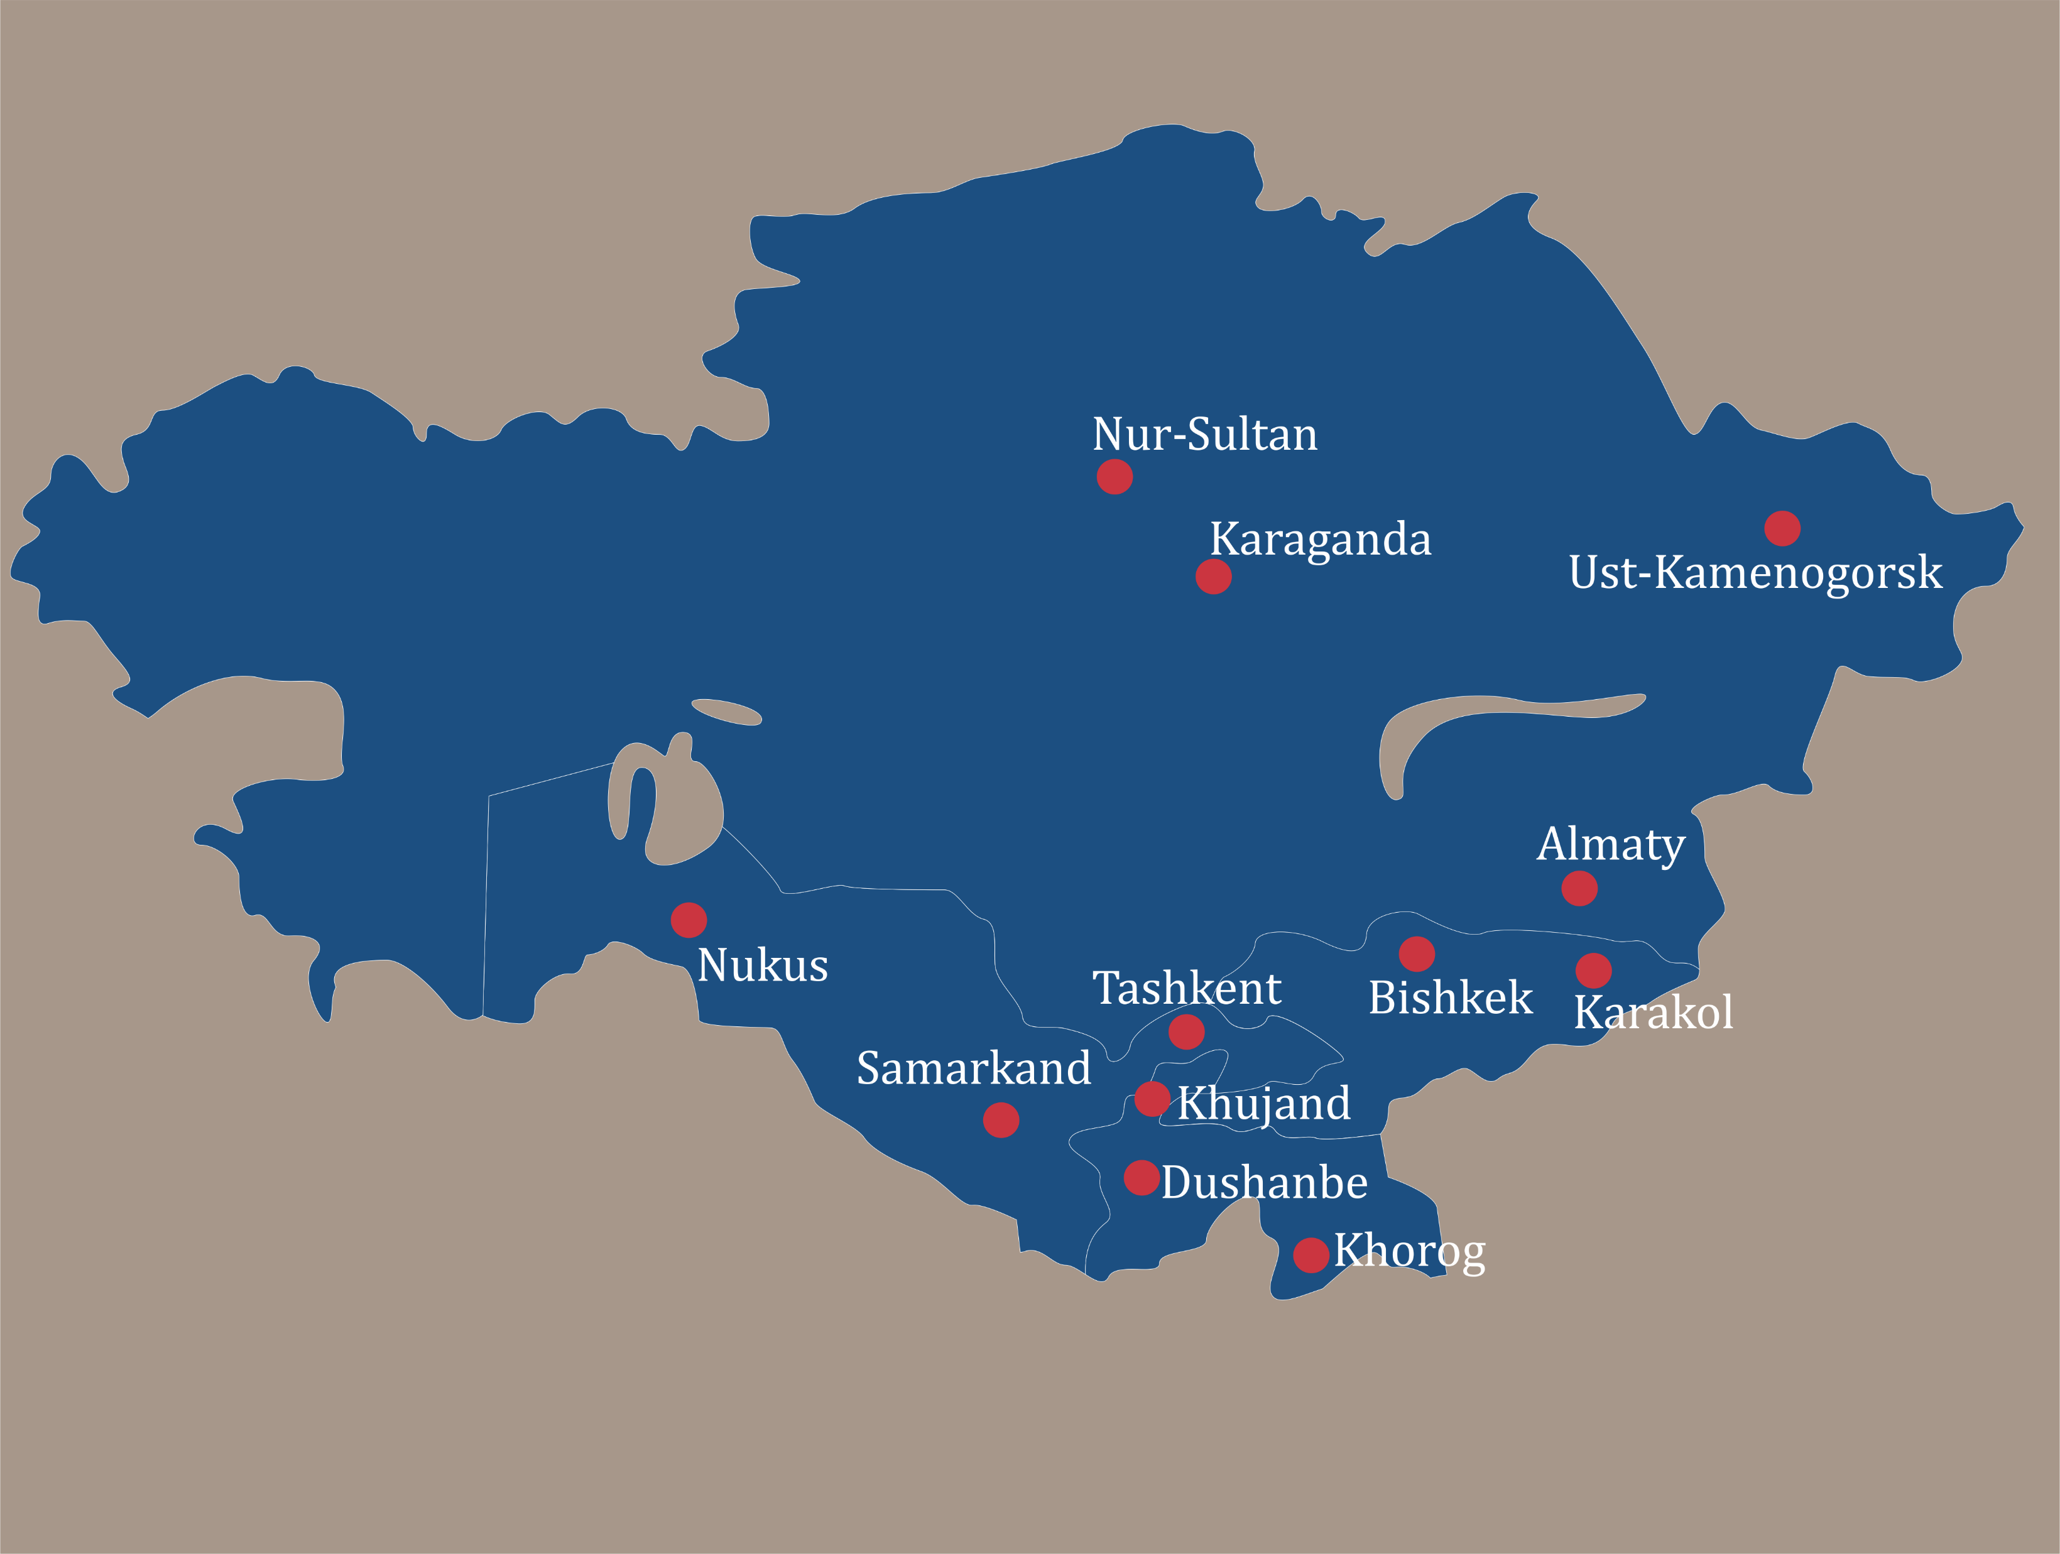
Admission 2020
CfA moved to mid-September – Deadline: 20 December 2019
Appointing “Academy Ambassadors” to travel CA universities
Including increasing numbers of donors & partners into Admission Committee to enhance transparency
Revising admission tests and interview guides (gender, commitment)
Expectation management

Slide 8
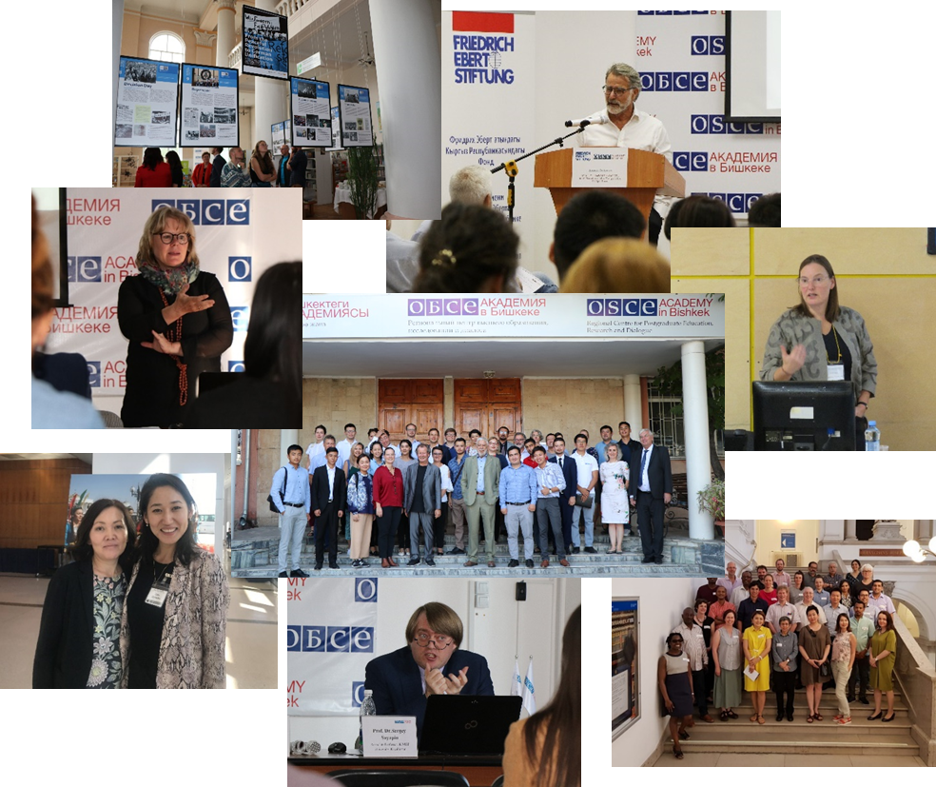
Research & Dialogue
Conference on System Transformation (20-21 September 2019)
Conference on Transitional Justice (12 October 2019)
Exhibition on 30 Years of Peaceful Transition in Germany
Workshop on Belt & Road Initiative (8 November 2019)
Horizon 2020: AGRUMIG engagement (First Meeting for the AGRUMIG consortium held in Vienna on 17-18 June; IOM’s and OSCE’s Tashkent Workshop on Migration Governance on 16-17 September 2019)
-> Kathmandu on 10-12 December 2019
Conference participation of Academy faculty / researchers: NESA (May, Bangkok), CESS (October, Washington), DKU (27 SEP, Almaty), HSE (19 OCT, St. Petersburg).
Notes:
NESA meeting “Difficulties and Opportunities of Connectivity” attended by Emil and Sveta (May, Bangkok),

Slide 9
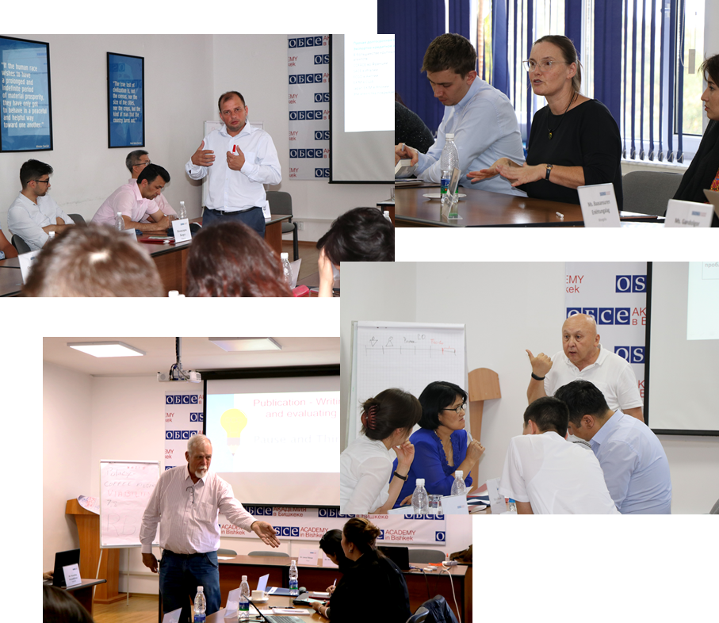
Trainings
Regulatory Impact Analysis on 24-28 June
Feasibility Studies for Investment Projects on 15-19 July
International Certificate Training Seminar in Human Rights in an International Context on 9-13 September
Policy Paper Writing Seminar on 21-25 October
Seminar on analytical writing in Kyrgyz language in November
International Certificate Training Programme in Conflict Sensitive Development in November

Slide 10
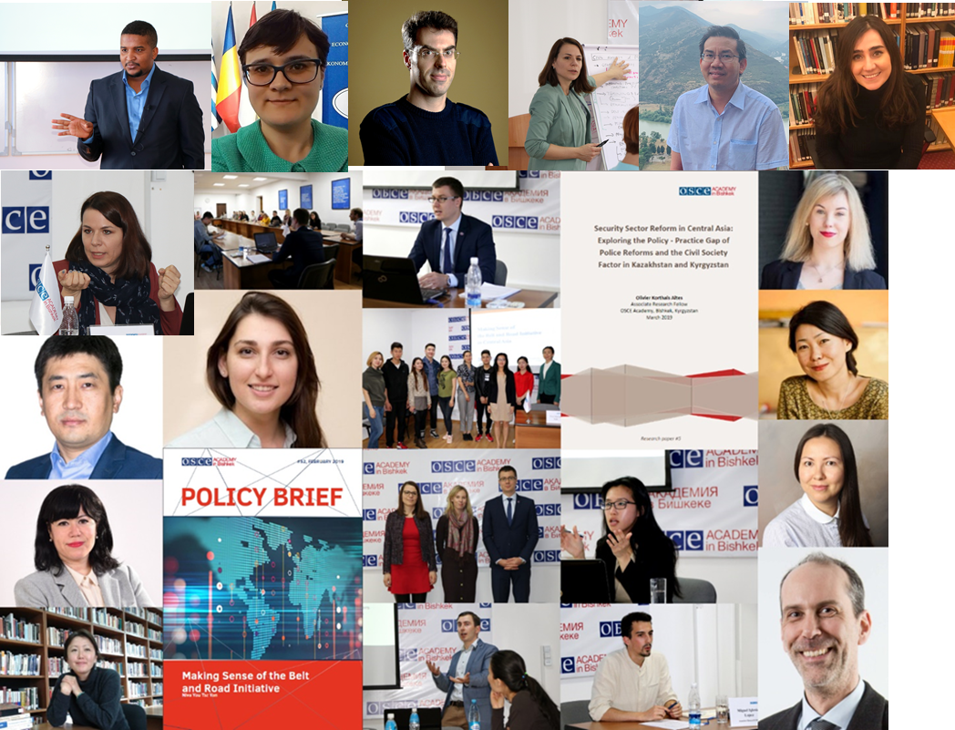
Associate Research Fellowship
Mr. Yazid Suleimani delivered a Public Lecture on “Belts and Roads Initiative Policy Framework I: Entrepreneurship” on 11 September 2019
Dr. Chiara Pierobon delivered a Public Lecture on "EU Prevention of Violent Extremism and Radicalization in Central Asia: A Case Study on Civil Society Engagement in Kyrgyzstan“ on 2 October 2019
Dr. Chiara Pierobon conducted research capacity-building training on Preventing Violent Extremism (PVE) on 7 October 2019.
Total number of ARFs reached 20 people.

Slide 11
International Cooperation
University of Lille (France) MoU signed on 19 September 2019
Osservatorio Asia Centrale e Caspio (Italy) in the process of negotiations
University of Valencia (Spain) Agreement signed on 1 July 2019
Higher School of Economics / St. Petersburg (Russia) in the process of negotiations
German Kazakh University (Kazakhstan) MoU signed on 7 February 2019
Sulkhan-Saba Orbeliani Teaching University (Georgia) MoC signed on 16 May 2019

Slide 12
Erasmus+
1 Erasmus+ mobility with National University of Political Studies and Political Administration (Bucharest, Romania)
4 applications submitted in Key Action 1 (mobilities) in February 2019 with partners from Tartu, Riga, Marburg, and Pisa.
All four applications were granted (TBC)
Around 20 applications in preparation for February 2020
(Unsuccessful) application submitted in Key Action 2 (capacity building) in February 2019 as part of Kyrgyz-European Consortium to create PhD
Head of IO to participate in Erasmus+ training & connectivity event in Riga on 4-8 November 2019

Slide 13
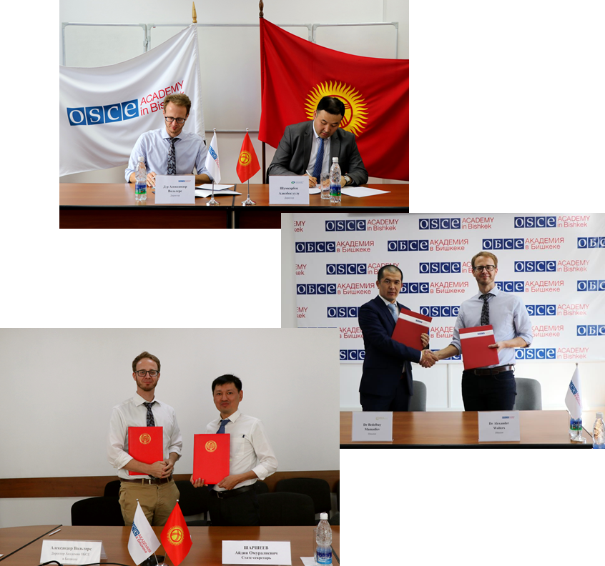
Regional Partnerships
Agreement with the Investment Promotion and Protection Agency of the Kyrgyz Republic prolonged on 8 October 2019
Ministry of Economy of the Kyrgyz Republic signed on 23 July 2019
Supreme Court of the Kyrgyz Republic
Ala-Too University in Bishkek to be signed in the beginning of November 2019
Judicial General Council of Mongolia to be signed in the beginning of November 2019
Ministry of Foreign Affairs of Afghanistan renewed on 13 October 2018
UNDP / UN Women / Aga-Khan Development Network
Regional Institute of Central Asia (RICA) signed on 8 October 2019

Slide 14
Alumni

Slide 15
Budget
2019 – Budget Implementation (as of 30 SEP 2019)
2020 – Budget Plan
2021 – Budget Projection
 | UB | ExB | NOR MFA / NUPI | EU | Total:
Budget Planned | 480,000 € | 569,093 € | 770,495 € | 10,784 € | 1,830,372 €
Budget Expenditures | 274,906 € | 258,078 € | 396,890 € | 3,021 € | 932,895 €
Budget Expenditures / 31 DEC 2019 | 480,000 € | 390,271 € | 770,495 € | 5,000 € | 1,645,766 €
 | UB | ExB | NOR MFA / NUPI | EU / 3rdPF | Total:
Budget Planned | 480,000 € | 672,647 € | 484,835 € | 50,000 € | 1,687,482 €
 | UB | ExB | NOR MFA / NUPI | EU / 3rdPF | Total:
Budget Planned | 540,000 € | 772,280 € | 484,835 € | 402,900 € | 2,200,015 €

