Slide 1
Presentation to the Board of Trustees
Vienna, 17 October 2018

Slide 2
Introduction
Funding
Budget 2018; Unified Budget; Extra-budgetary Funding; Third-Party Funding
Administrative Reforms
Accounting Policy; HR policy; Charter of the Academy
Master Programmes
Applications & Enrollment; Summer School; Admission 2019; Internships; Programme Development
Faculty Development
Full-time positions; Visiting Lecturers; Capacity building & PhD programme
Research & Dialogue
Conferences; Publications; ARF; Horizon 2020; Upcoming Projects
Professional Trainings & Workshops
Cooperation with IWPR; Masterclass; Upcoming Projects
Alumni Affairs
Statistics; Travel Grants; Alumni Meetings & Conferences

Slide 3
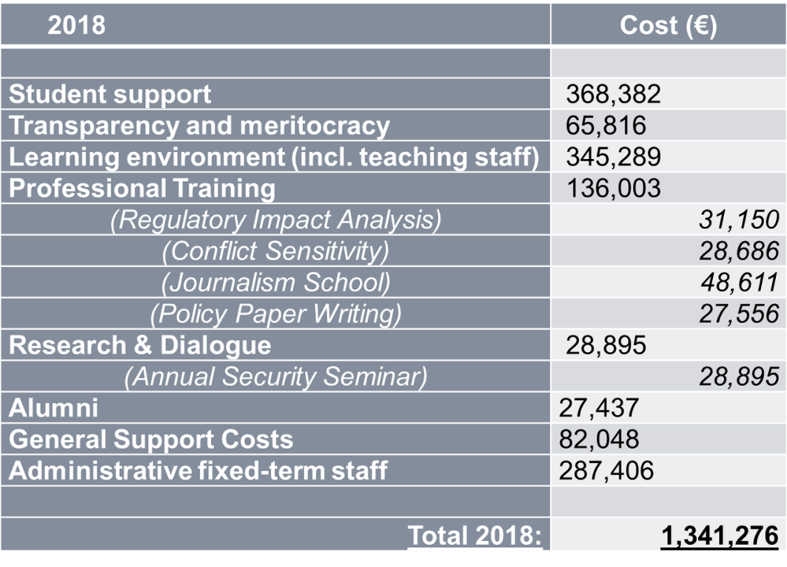
Funding – Planned Budget 2018

Slide 4
Funding – UB
2018:
Until 2017 funding from UB amounted to 247,000 EUR (incl. Director’s salary)
As of 2018 funding has been increased to 317,000 EUR allowing additional coverage for construction & renovation as well as increased audit costs
2019:
For the upcoming year a further increase to up to 480,000 EUR is envisaged. This enhance should enable to the Academy to:
Strengthen its faculty body by creating 3 full-time lecturer/researcher positions
Increase the number of students enrolled in 2019
Organise an enhanced summer school programme in August 2019
Increase and professionalize publications in both English and Russian

Slide 5
Funding – ExB
2018:
Funding budgeted in the amount of 429,948 EUR in 2018; Secured with generous contributions from Austria, Finland, Switzerland, and the United States
2019:
ExB Project envisages funding for Students, Academics, Meritocracy, Alumni in 2019 and 2020 in the amount of 558,533 EUR and 743,485 EUR respectively (Increase in 2019 due to additional support to Academics; in 2020 due to additional support to Students + audit)
ExB funding for 2019 secured in the amount of 342,619 EUR with a further request for Funding in the amount of 215,914 EUR!
Letter of intent from German MFA about funding in the amount of 80,000 EUR (as yearly contribution starting in 2019 and continuing indefinitely)
ExB funding for 2020 secured in the amount of 159,137 EUR with further request for Funding in 2020 in the amount of 584,348 EUR

Slide 6
Funding – Third Party
2018:
NUPI contributes 465,213 EUR in 2018 (including re-allocation from 2017 this amounts to 548,386 EUR)
Switzerland has added ~33,500 EUR (40,000CHF)
2019:
NUPI funding for 2019 amounts to ~625,000 EUR including costs for activities that have been implemented by NUPI directly in the past but today are administered by the Academy (e.g. CADGAT, Research Mentoring).
In 2019 the Academy will also benefit from its successful applications to Erasmus+, Horizon 2020, DAAD, its continuous cooperation with IWPR and other partners who engage into sharing costs to implements various activities.

Slide 7
Administrative Reforms
Accounting Policy:
Separate set of Budgeting and Accounting Regulations currently developed
Introduction of 1C accounting software installed in the Academy; financial staff undergoes corresponding trainings to enhance skills in using 1C
Human Resources Policy:
Corresponding chapters of the Academy’s Operational Manual are currently updated and transformed into a separate document, regulating hiring and contracting of staff, faculty, visiting researchers and affiliates
Teaching Positions at the Academy be filled with in-house faculty, Visiting Lecturers from partner institutions (following Memorandum of Cooperation), and by means of competitive selection procedures
Review of Charter of the OSCE Academy:
A mid-term goal of the Academy’s reform efforts is to upgrade the Charter of the Academy in order to allow the expansion of the number of trustees in the Board as well as the strengthening of the Board’s supervisory function vis-à-vis the Academy

Slide 8
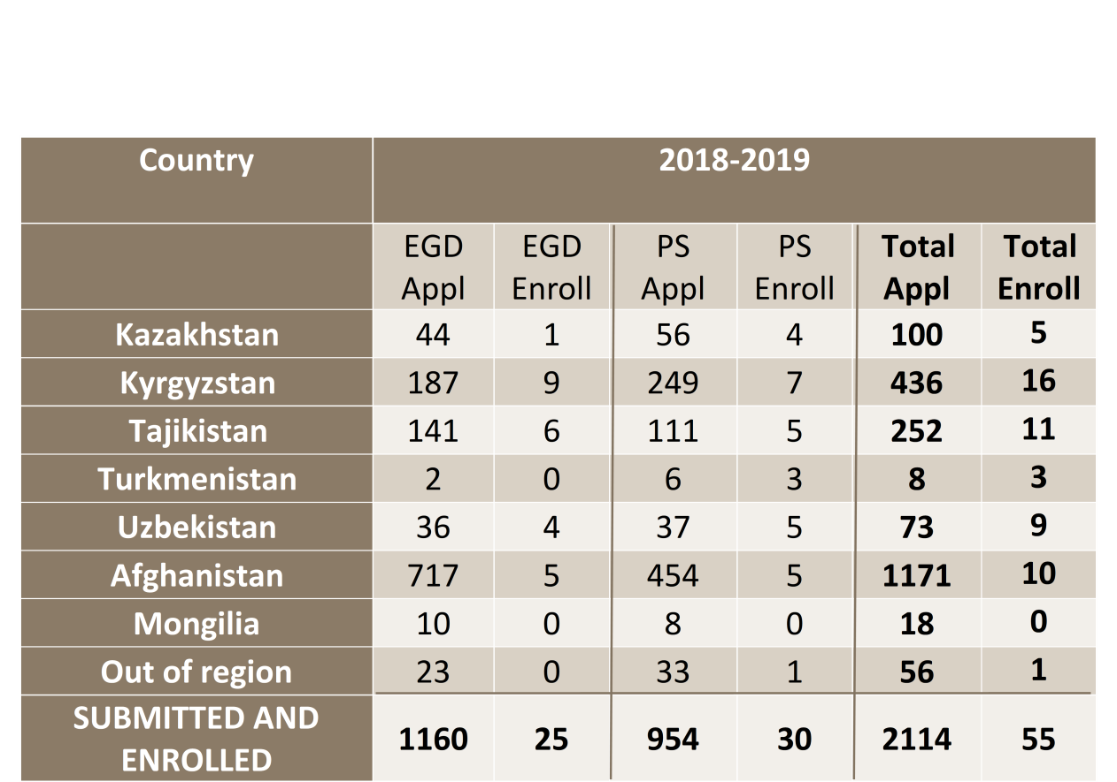
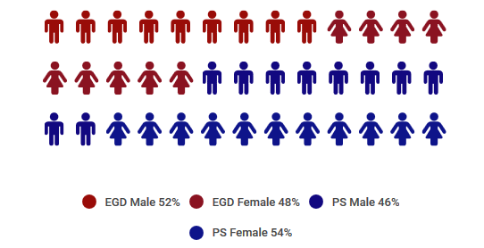
Master Programmes
Gender distribution

Slide 9
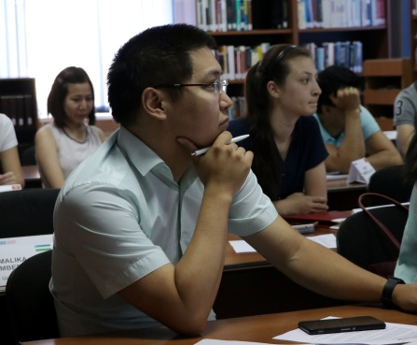
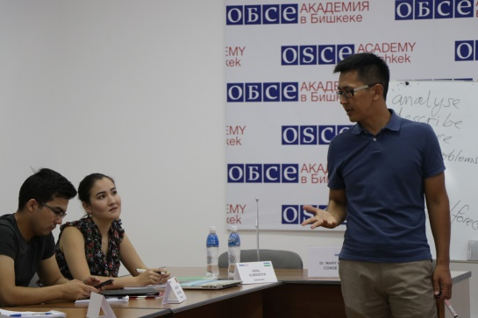
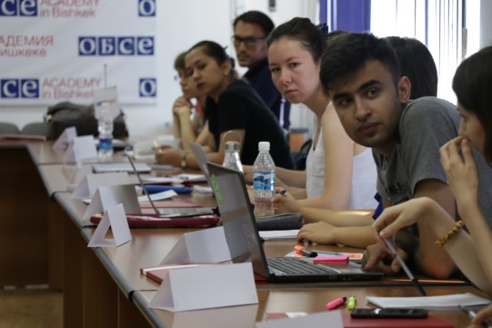
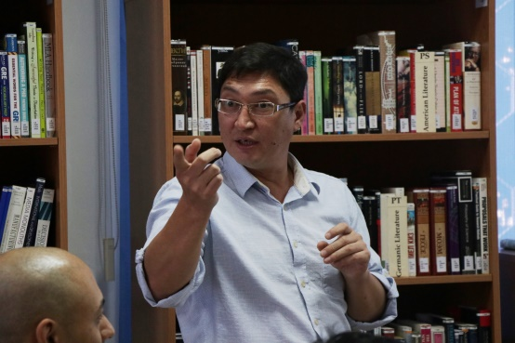
Master Programmes – Summer School
2018:
The pilot Preparatory Summer School Programme lasted from 13-31 August and gathered 80 students and graduates for advanced training courses in mathematics & statistics, research methods, and academic writing. The groups consisted of:
Students selected for both MA programmes for the academic year 2018/19
Students put on the reserve list for both programmes for the academic year 2018/19
Students selected following a call for applications on July 11 - more than 400 applications were received out of which 20 students were selected to join the summer school
2019:
The summer school 2019 is scheduled for 5-31 August and open to up to 100 participants. Funding for the school will to be allocated from UB, ExB, and 3P sources.

Slide 10
Master Programmes – Admission 2019
Taking into consideration the increase in applications and the objective to keep high levels of transparency and meritocracy, the admission process for the academic year 2019/2020 will begin October 20 with the announcement of the Call for Applications
Admission Schedule:
October 20 – Announcement
January 15 – Deadline for submission
February 28 – Shortlisting for Test
March & April – Testing and Interviewing
May 15 – Final selection commission session
The Academy seeks to enroll 30+ students per MA programme from its seven programme countries and from outside the region (wider OSCE area)

Slide 11
Master Programmes – Internships
Confirmed Partnerships with:
OSCE Secretariat in Vienna (up to 5 positions)
OSCE HCNM in The Hague (1 position)
NUPI in Oslo (up to 4 positions)
New Partnerships in 2018:
European Centre for Minority Issues in Flensburg (up to 3 positions)
Geneva Institute for Security Policy in Geneva (up to 2 position)
Aleksanteri Institute in Helsinki (1 position)
Austrian Study Centre for Peace and Conflict Resolution in Stadtschlaining (up to 3 positions
In preparation for 2019:
German Development Institute in Bonn (1 position)
German Institute for International and Security Affairs in Berlin via DAAD funding (up to 2 positions)
ODIHR Democratization Department (up to 2 positions)

Slide 12
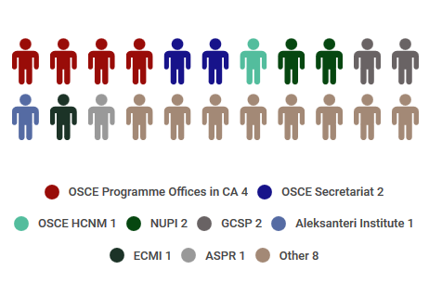
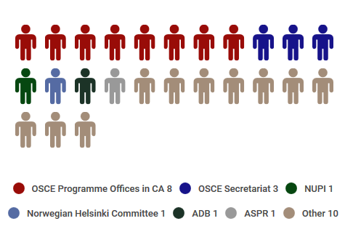
MA Programmes – Internships 2018
MA in Politics and Security
MA in Economic Governance and Development

Slide 13
Master Programmes – Development
In its effort to improve its educational programmes the Academy strives to introduce new modules and seminars and increase its additional activities for students:
Politics & Security
Central Asia and China (St. Petersburg University)
ODIHR (Democratic Governance Department, ODIHR)
Cybersecurity (Erasmus University Rotterdam)
Economic Governance & Development
Methods in Economic Anthropology (University of Freiburg; UN Women Kyrgyzstan)
Both Programmes
Qualitative Social Research Methods (Georg Eckert Institute for International Textbook Research)
UN in Central Asia and Afghanistan (UNAMA)

Slide 14
Faculty Development – Full-time Positions
Since June 2018 three full-time positions have been established and successfully filled:
Regional Scholarship to Dr. Emil Juraev (Politics & Security Programme)
Fields of expertise are democratization theory, constitutionalism, Central Asian politics
Regional Scholarship to Dr. Nazgul Zhenish (Economic Governance & Development Programme)
Fields of expertise are econometrics, Entrepreneurship in Central Asia, mathematics for economics
Both positions have been made possible with funding from Switzerland for the period until end of March 2021
DAAD Visiting Professor Dr. Anja Mihr (Politics & Security Programme)
Fields of expertise are Human Rights, Transitional Justice,
DAAD funds this position for the period for up to five years

Slide 15
Faculty Development
New Visiting Lecturers
For May & June 2019 visiting professors Dr. Yana Leksyutina from St. Petersburg State University and Dr. Yulia Nikitina from MGIMO for modules on Central Asian foreign policy (with support from the Gorchakov Foundation)
Dr. Philipp Schröder from University of Freiburg & UN Women Kyrgyzstan for module on Economic/Entrepreneurial Anthropology
Dr. Barbara Christophe of the GEI of International Textbook Research for extended module on qualitative social research methods open to both MA programmes in Spring semester
Capacity Building & PhD Programme
Erasmus+ Consortium with AUCA and ADAM University - Academy partner is the Johan Skytte Institute of Political Sciences at Tartu University
Erasmus+ applications in Key Action 1
Erasmus+ application together with NUPSPA in Bucharest for funding in Key Action 1 (Exchange of students and faculty) received positive answer
Up to six partnerships with universities in Germany, Estonia, Spain, Romania, Latvia, Poland planned for period 2019/2020

Slide 16
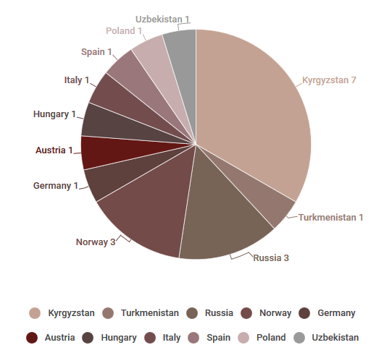
Faculty Development

Slide 17
Research & Dialogue - Conferences
Dialogue and Research is part of the mission of the OSCE Academy. Today the institute hosts several regular events to bring scholars together and to support research on security and development in the region:
The Annual Security Seminar, held in Fall each year, invites scholars from the region and further afar to discuss topics related to classical questions of regional integration, security, state, and development
Recent ASS held 12-14 October
The “Non-Traditional Risks and Challenges to Central Asian Security” Conference held in May 2018 served as a platform for scholars from Eurasia to discuss alternative views on questions of security and development in Central Asia
Next N-TRC Conference planned for Spring 2019
Regular visits and presentations by representatives of OSCE pS and from OSCE institutions offer insights to students and guests of the Academy on various aspects of the security architecture in Central Asia and the wider region.
May 2018: SG Greminger; May 2018: Swedish AMB Camille; July 2018: Afghan AMB (OSCE Del) Ebrahimkhel; Oct 2018: Head of Institute of Diplomacy of Afghan MFA, Dr Spinghar

Slide 18
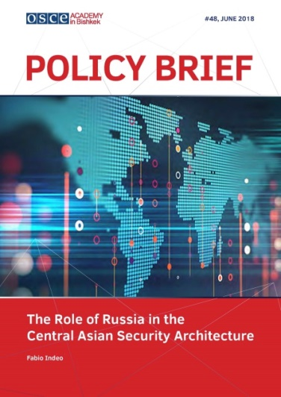
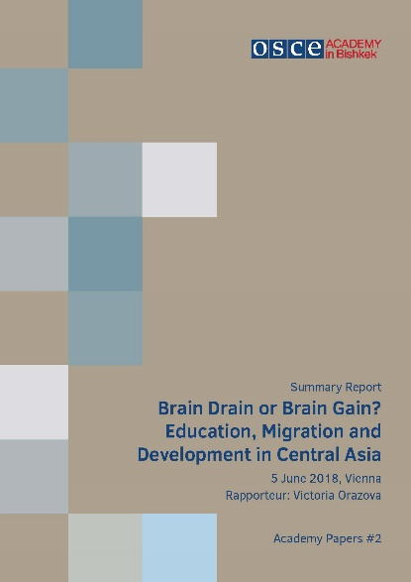
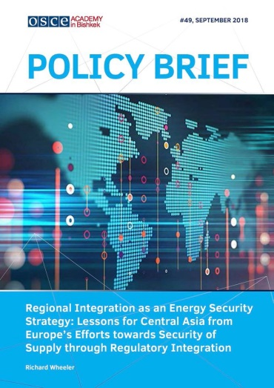
Research & Dialogue - Publications
In the reporting period several new publications were issued in English and Russian:
Policy Brief No.48: The Role of Russia in the Central Asian Security Architecture By Fabio Indeo (also in Russian available)
Policy Brief No.49: Regional Integration as an Energy Security Strategy: Lessons for Central Asia from Europe’s Efforts towards Security of Supply through Regulatory Integration By Richard Wheeler
Ежегодный сборник аналитических статей
Academy Papers #2, «Утечка или приток мозгов? Образование, миграция и развитие в Центральной Азии»

Slide 19
Research & Dialogue - Developments
Associate Research Fellowships
Academy as place to conduct research / organize field studies in Central Asia
Five Associate Research Fellows since December 2017
Horizon 2020
Academy is part of a consortium (lead by SOAS/UoL) that successfully applied with research project AGRUMIG – studying the interrelation between agriculture & migration
Academy acts as policy impact partner
Upcoming Projects
Marburg University – Consortium to apply for research with LOEWE project (Regions of Conflict in Eastern Europe)
OSCE Network – Workshop on Human Rights / Democratization
‘Global Issues / Integrating Different Perspectives on Social Inequality’ (Volkswagen Foundation; novonodirsk fonden; Riksbankens Jubileumsfond; Compagnia di SanPaolo)

Slide 20
Professional Trainings & Workshops
Professional Trainings are an integral part of the OSCE Academy programmatic activities. Several trainings are being offered on a regular basis:
Certificate Programmes
Certificate Programme on Human Rights and Conflict Sensitivity & Policy Paper Writing Seminar
CP 2017: 14P; PPWS 2017: 12P; PPWS 2018:12P; CP 2018: 24
Feasibility Studies Programme
Regulatory Impact Analysis & Feasibility Studies for Investment Projects
RIA 2017: 13; RIA 2018: 21; FS 2017: 28; FS 2018: 19
Journalism Training with IWPR
Investigative and Analytical Journalism IWPR/OSCE Academy Workshop & Policy Brief Writing IWPR/OSCE Academy Workshop
IAJ 2018: 28; PBW 2018 : 20
Advanced Training Programme
Pilot Programme - Masterclass: Interviews as Method in the Social Sciences & Humanities
MC 2018: 10

Slide 21
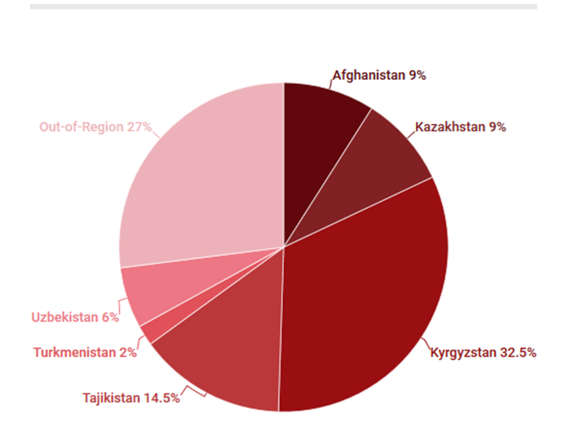
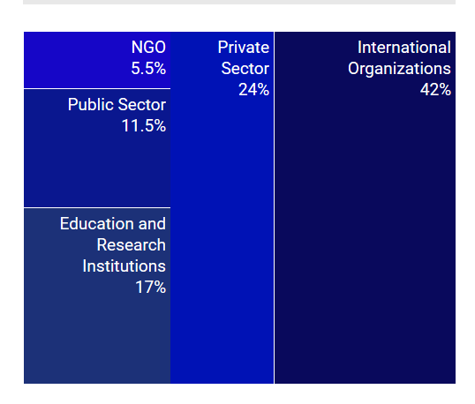
Programmes - Alumni
The Alumni community of the OSCE Academy is steadily growing and the relations between the Academy and its graduates increasingly begins to materialize in form of new projects and educational initiatives
Statistics of Academy Alumni | numbering 427
Geography of Residence Employment by Sectors
(Currently 26 Alumni are pursuing PhD!)

Slide 22
Alumni Affairs - Developments
Workshops / Chapter Meetings
Alumni Workshop on Gender Issues (Feb 2018)
Chapter Meeting in Dushanbe (Apr 2018)
Chapter Meeting in Kabul (May 2018)
Academy Alumni Meeting in Vienna (June 2018)
Travel Grants
Assel Mussagaliyeva '05 PS for attending “Sustain and Retain: The Place of Sustainability within Conservation”, Workshop at Cambridge University | March 2018.
Aigerim Almazova '17 EGD for travel to Geneva for internship at WTO Headquarters | March 2018
Arzu Sheranova ‘15 PS for attending international seminar on publication strategies for PhD students in Tallinn | 4-6 September
Karlygash Kabatova ‘’14 PS to present at the 21st European Regional International Association for Adolescent Health (IAAH) Conference | 3-5 October, 2018
Alumni Conference in October 2018 as part of the ASS

