Slide 1
Meeting of the Board of Trustees
4 June 2019
Vienna

Slide 2
Table of Contents
Budget & Funding
Reform & Development
Educational Activities
Research & Dialogue
Partnerships & International Cooperation
Requests for BoT Approval

Slide 3
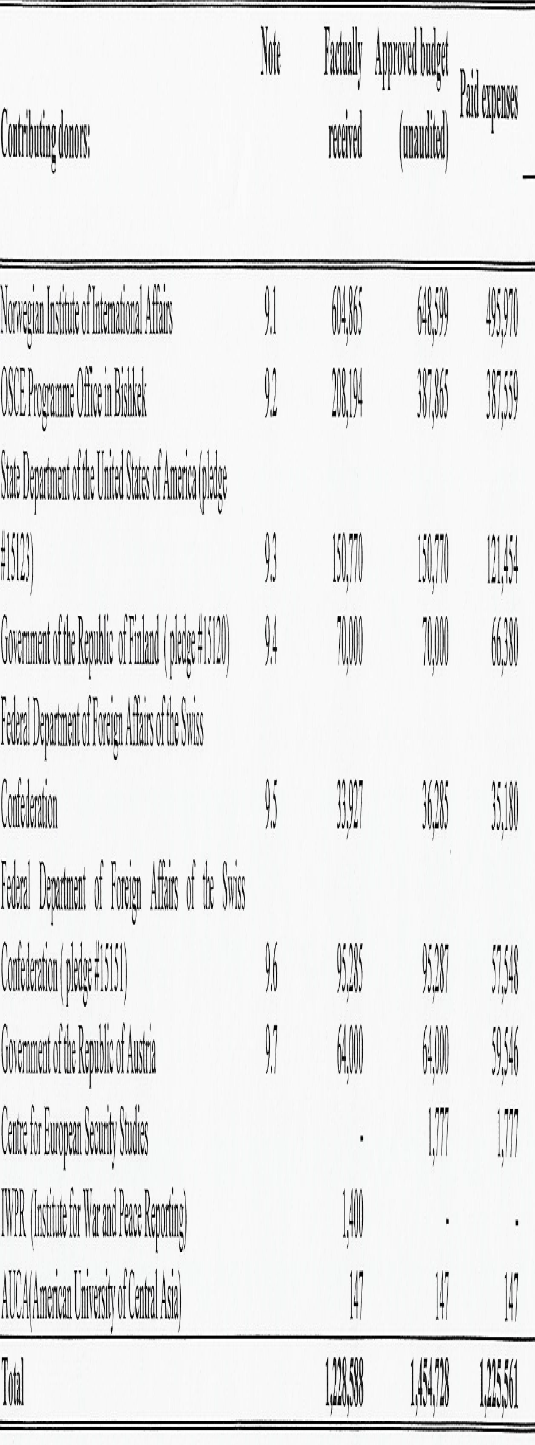
Budget & Funding - 2018
Audit Report by MarkaAudit for 2018:

Slide 4
Budget & Funding - 2019
 | Planned
Needs / Tasks | Total: | UB | ExB | NUPI | EU
Students
Sub-total: | 494,148.26 € | 83,542.00 € | 192,420.00 € | 218,186.26 € | 0.00 €
Merit-based practices
Sub-total: | 57,737.00 € | 0.00 € | 43,224.00 € | 14,513.00 € | 0.00 €
Quality teaching
Sub-total: | 437,415.42 € | 21,600.00 € | 318,703.00 € | 97,112.42 € | 0.00 €
Alumni
Sub-total: | 58,306.74 € | 0.00 € | 9,746.10 € | 48,560.64 € | 0.00 €
Professional trainings
Sub-total: | 108,688.68 € | 0.00 € | 0.00 € | 108,688.68 € | 0.00 €
Research
Sub-total: | 201,178.98 € | 22,200.00 € | 0.00 € | 168,194.60 € | 10,784.38 €
Library
Sub-total: | 10,500.00 € | 0.00 € | 5,000.00 € | 5,500.00 € | 0.00 €
Staff & Other
Sub-total: | 462,397.40 € | 352,658.00 € | 0.00 € | 109,739.40 €
Total: | 1,830,372.48 € | 480,000.00 € | 569,093.10 € | 770,495.00 € | 10,784.38 €

Slide 5
Budget & Funding - 2020
 | Planned
Needs / Tasks | Total: | UB | ExB | NUPI | EU
Students
Sub-total: | 583,441.00 € | 83,542.00 € | 340,721.00 € | 159,178.00 € | 0.00 €
Merit-based practices
Sub-total: | 102,642.00 € | 0.00 € | 95,442.00 € | 7,200.00 € | 0.00 €
Quality teaching
Sub-total: | 351,565.00 € | 21,600.00 € | 297,966.00 € | 31,999.00 € | 0.00 €
Alumni
Sub-total: | 60,258.00 € | 0.00 € | 20,336.00 € | 39,922.00 € | 0.00 €
Professional trainings
Sub-total: | 36,971.00 € | 0.00 € | 0.00 € | 36,971.00 € | 0.00 €
Research
Sub-total: | 171,722.00 € | 0.00 € | 0.00 € | 146,722.00 € | 25,000.00 €
Library
Sub-total: | 15,000.00 € | 0.00 € | 5,000.00 € | 10,000.00 € | 0.00 €
Staff & Other
Sub-total: | 461,651.00 € | 374,858.00 € | 0.00 € | 86,793.00 € | 0.00 €
Total: | 1,783,250.00 € | 480,000.00 € | 759,465.00 € | 518,785.00 € | 25,000.00 €

Slide 6
Reform & Development
Replacement of “Operational Manual”
(revised in 2016) with:
HR Policy
Regulations for Office Work
Financial Policy
Code of Conduct

Slide 7
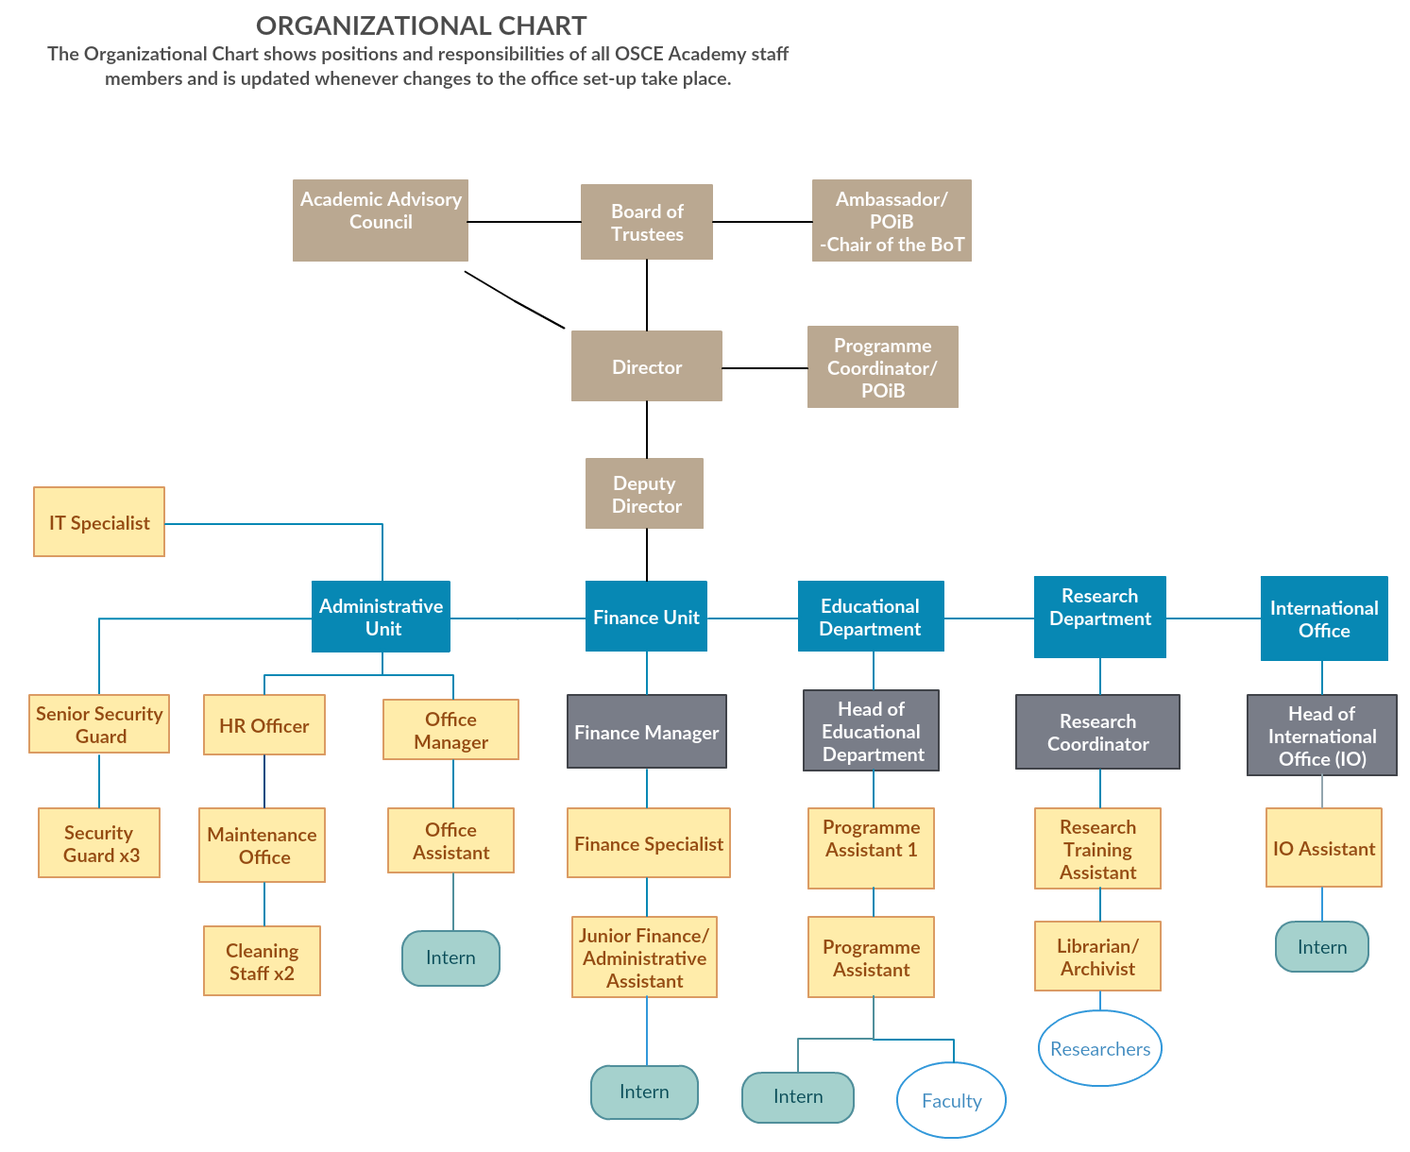
Reform & Development - Organigram

Slide 8
Educational Activities – Admission for 2019-2020
 | Economic Governance and Development |  |  | Politics and Security
Country | Enrolled total | Enrolled male | Enrolled female | Enrolled total | Enrolled male | Enrolled female
Afghanistan | 10 | 7 | 3 | 9 | 7 | 2
Kazakhstan | 0 | 0 | 0 | 2 | 1 | 1
Kyrgyzstan | 5 | 0 | 5 | 9 | 4 | 5
Tajikistan | 2 | 2 | 0 | 6 | 5 | 1
Turkmenistan | 1 | 0 | 1 | 1 | 0 | 1
Uzbekistan | 2 | 2 | 0 | 3 | 3 | 0
Mongolia | 1 | 0 | 1 | 0 | 0 | 0
Out of region | 0 | 0 | 0 | 2 | 1 | 1
Sum | 21 | 11 | 10 | 32 | 21 | 11

Slide 9
Educational Activities – Summer School
Scheduled for 5-31 August; call open from 15 May till 15 June
Participation: all invited MA programme applicants & reserve list candidates + up to 30 additional interested young graduates
Rules of Admission allow for selected admission via Summer School, when:
Information shared in Advance; funding available to guarantee equal access to Summer School from the region; selection process follows norms set forth in general admission rules; admission rules approved by Kyrgyz Ministry of Education and Sciences; approval by the Board of Trustees

Slide 10
Educational Activities – Internships
OSCE Secretariat
NUPI
Geneva Centre for Security Policy
NEW since 2017: Aleksanteri Institute, ECMI, ASPR
NEW in 2019: UNAMA, GEI, ODIHR; (SWP)

Slide 11
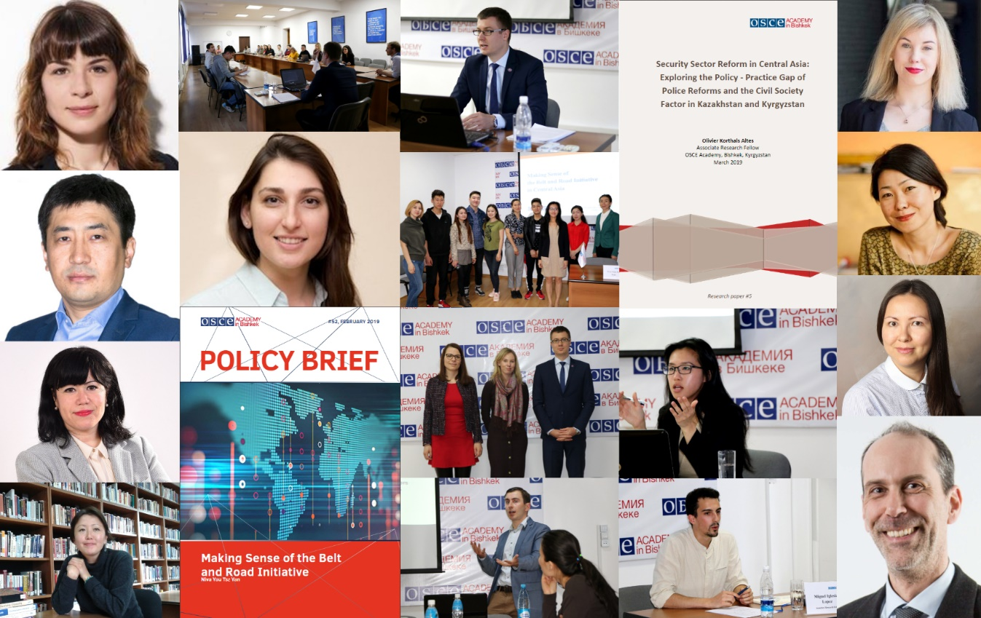
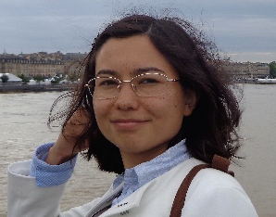
Research & Dialogue – Associated Research Fellows
Launched in late 2017;
Aims to support researchers in conducting projects and provide institutional affiliation;
Length of the fellowship from 6 to 12 months;
Academy provides with access to the library and all available online resources;
Fellows required to present research and deliver lecture;
Total number of ARFs reached 14 in April 2019

Slide 12
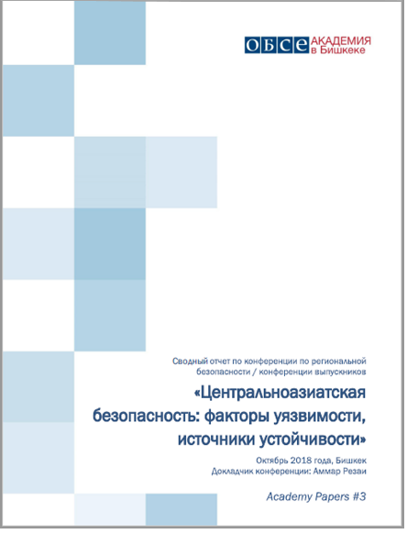
Research & Dialogue – Policy Briefs

Slide 13
Research & Dialogue
Horizon 2020 – AGRUMIG
Project aims to study relation between agriculture and migration and to contribute to policy formation
OSCE Academy joined consortium under lead SOAS in March 2018; approval in July 2018; inaugural meeting in April 2019
OSCE Academy serves as policy partner with UCA as research institution for country case Kyrgyzstan
Applying to FPI funding:
“Instrument contributing to Stability and Peace (IcSP) - Support to civil society actors in promotion of Dialogue and Prevention of Violent Extremism (PVE) in Central Asia”
Deadline 23 AUG 2019

Slide 14
Research & Dialogue
Research Scholarships at the Academy
Savings from NUPI to start first independent research activities;
Implementing research challenging considering local legislation;
Springer / Open Access Publication
Conferences:
IEP / EUCACIS; DAAD / Bio-Economy; NUPI / CADGAT & RM; faculty participation

Slide 15
Partnerships & International Cooperation
Erasmus+
Application submitted for funding in Key Action 2 (capacity building) in February 2019 as part of Kyrgyz-European Consortium to create PhD
4 applications submitted for funding in Key Action 1 (mobility) in February 2019 together with European partners from Tartu, Riga, Marburg, and Pisa.
Results expected in Summer 2019

Slide 16
Partnerships & International Cooperation
DAAD
Full-time Visiting Professor Dr. Anja Mihr; symposium; training; summer school (together with SWP)
Gorchakov Foundation
Visiting Professor Dr. Yana Leksyutina from St. Petersburg State University
German-Kazakh University
Cooperation for Student exchange and visiting fellows: Dr. Sebastian Meyer as new ARF

Slide 17
Request – BoT Approval
Summer School Admission
Audit for 2018
Consolidated Budget 2019
New Admin Regulations (normative acts)

