Slide 1
How to Deal with Complex Policy Decisions? Poverty and Social Impact Analysis (PSIA) for CU policy-making in Kyrgyzstan
for Conference on Regional Integration in Bishkek, 14.-15. November 2012
Elke Kasmann, GIZ, Eschborn

Slide 2
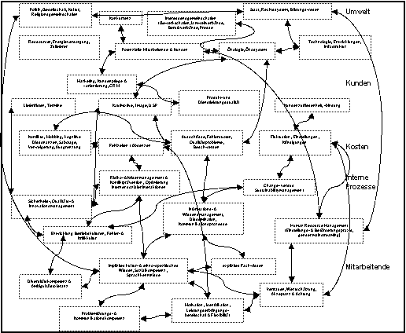
PSIA – Poverty and Social Impact Analysis
Economic Impacts of CU/ EurAsianEC
Social Impacts of CU/ EurAsianEC
Notes:
Warm welcome - from GIZ headoffice in Germany
Zarema Kassendayeva - giz program area of economic development,
Since last year discussing the idea to work on social consequences of CU
Became apprent that
Complex – no full picture
- as picture shows: many factors – all influencing each other, ín various ways and directions, ….
Economic and social lense
Looking at Imports, export, industries or at Income, jobs, poverty
Lots of economic studies - hardly any social
We launched a first, small, qualitative study on Dordoi – one part but important for the country and in Bishkek – we will hear more from this later
Discussions we have led this time convinced us
There is indeed a need and a demand for more thorough knowledge on social consequences
With Russia‘s accession to WTO & perspective of EurAsianEC the picture becomes even more complex and unsure
BUT the good news is: there is less pressure and more time to get prepare!
So, this WS a kick-off for a GIZ engagement in a longer process of producing knowledge on the social consequences of the changing trade regime and inform government accordingly.
We will use PSIA methodology
PSIA standing for poverty and social impact analysis –
And beeing an internationally established instrument for policy analysis and advise.

Slide 3
From Trade Policy to Household Welfare
Notes:
What is at the heart of PSIA?
PSIA analyzes how macro level changes influence HH welfare – the very resources hh have to make their living
As the graph shows
changes in tariffs, in taxes, transport costs are transmitted through various mechanisms down
And finally reach each citizen at the hh level through various transmission channels:
These are:
1
2
3
4
That is what is called transmission channel analyses in PSIA work
The second PSIA feature is that it asks the question: Are specific social groups affected differently?
What does it mean for poor hh? What for the richer?
Are there differences between rural and urban hh? Or between citizens in the southern and northern parts of the country?
PSIA always keeps a special eyes on the poorer and vulnerable groups.

Slide 4
Instruments: economics tools
Direct impact
Cost-benefit analysis
Tax incidence analysis
Poverty mapping
Behavioral models
Ex-ante behavioral marginal incidence analysis of public spending
Supply and demand analyses
Household models
Partial and general equilibrium models (multi-markets, reduced, social accounting matrices, CGE)
Micro-macro analyses
PovStat
123 PRSP
Poverty Analysis Macroeconomic Simulator (PAMS)
Known and tested intruments
No specific PSIA-tools

Slide 5
Instruments: social tools
Macro level
Country and reform context
Power analysis, Drivers of Change
stakeholder matrices
Network analysis, political mapping
Meso level
Institutional analysis
Analyzing spheres of influence
Micro level
Participatory poverty assessment
Household surveys
CoIMPact (former QUIM)
Focus Group Discussion
Known and tested intruments
No specific PSIA-tools

Slide 6
Which are the most important Aspects here?
Traders, Daily Labourers
Dordoi Market
Effects of rising prices on household welfare
Effects on agricultural producers & food security
Notes:
Coming back to the complexity of the situation
We will not be able to analyze a net effect, summing up the positive and negative impacts and make an equation
But: we can shed light on certain pieces of the puzzle
We have chosen Dordoi market and the social impacts CU will have on traders and daily labourers to begin with.
Dordoi is the biggest market not only in the country; it is very important for the economy and it provides a lot of jobs.
What will be the other pieces to be analyzed?
Where do we expect the coming changes in trade regime will hit the hardest?
The rising consumer prices might be one important issue.
With many households living very near to the poverty line,
even a light but broad increase in consumer prices might make the difference between making ends meet somehow and not being able to support the family
Another issue might be the agricultural producers:
Will a new trade regime impact on their incentive to produce? Will it change input costs? Will it change their ability to sell? And how does all this transmit to their ability to sustain their families and to contribute to the national food base?
We will have to discuss this later
So that we get an orientation about the direction of further PSIA studies.

Slide 7
….Issues selected for further study
Social impacts of CU on Dordoi Market in Bishkek
Traders and daily laborers ….
Qualitative study
Welfare effects of price changes
How do price changes on the level of the world market/ CU/ national market influence welfare on household level (consumption and income)?
Poverty and Macroeconomic Simulator/ PAMS
Impact of CU on food security, subsistence production and national food markets
Qualitative study
Exploration of mechanisms of transmission (informal economy, informal food exports, monopolistic market structures, actual implementation by customs officials at the borders

Slide 8
PSIA Approach: Studies AND Process
Political Level
Advise on relevant PSIA topics
Provide quality controlled study results (policy briefs)
Technical Level
PSIA
Secretariat
Commission and steer studies
Organize technical review and quality control for studies
Summarize findings and technical reviews into policy briefs
PSIA Studies
& review of findings
with technical experts
14.11.2012
Notes:
How do we envisage the PSIA study process to operate?
Secretariat
Receive advise from political level
Their tasks are to: ……….
provide the knowledge generated and reviewed to the political level
So, in the PSIA process we are dealing with technical work
Social impacts – solid knowledge
Generating indicators for policy making;
Showing policy options and their advantages and disadvantages
No simple answers, because
Too high complexity
Other considerations playing in which are purely polticial, around geo-strategic and national security issues
And this technical character should also lead us during this roundtable today.

Slide 9
Why good process is important
Bringing in the technical knowledge from within the various organisations of Kyrgyzstan
Connecting regional and international expertise to local expertise
Incorporate multiple perspectives from different stakeholders, as business community, Government offices, implementing agencies, civil society,..
mature study concept for study team
solid review of findings by a broad range of stakeholders
well digested and focused policy briefs for decision-makers

Slide 10
How could PSIA support Government Decision Making in CU matters?
Create evidence on social impacts for different regions, rural and urban households, etc.
Informing negotiation arguments for sequencing, scope, preferences, etc. of CU accession: providing figures on social costs for the government
Informing policy preparation for adapting and mitigation measures; e.g. social benefit system, active labor market measures….
Notes:
So what do we do with the generated knowledge?
The PSIA work is meant to support government,
to inform decision-making in relation to CU/trade policy matters.
The evidence created on social impacts shall inform government decision-making in two main areas:
The negotiations on CU/EurAsianEC
Provide indications which areas require special protection, be it special tariff conditions or preferences for certain products,
And figures on social costs for bargaining
2) Policy preparation for social programs to help very hardly hit population groups to adapt and to compensate certain losses of income opportunities

