Slide 1
Society and energy transition
Rahat Sabyrbekov
OSCE Academy
Bishkek, 2023

Slide 2
Hainsch, Karlo & Löffler, Konstantin & Burandt, Thorsten & Auer, Hans & Crespo del Granado, Pedro & Pisciella, Paolo & Zwickl-Bernhard, Sebastian, 2022. "Energy transition scenarios: What policies, societal attitudes, and technology developments will realize the EU Green Deal?," Energy, Elsevier, vol. 239(PC).

Slide 3
Introduction
First, an extensive review of European energy transition pathways considering high GHG emission reduction targets for 2050 is conducted which highlights the current landscape of decarbonization scenarios
Second, a novel scenario development process based on a three-dimensional approach is introduced along with a brief discussion of the results of the openENTRANCE pathways
Lastly, these results are mirrored against similar other pathways which analyze European decarbonization scenarios to determine common findings and recommendations which are then, in a second step, highlighted in the context of the European Green Deal

Slide 4
Review of European energy transition pathways
European Commission scenarios
Energy Roadmap 2050 scenarios: four key technological developments: energy efficiency, renewable energy, nuclear energy and carbon capture and storage
Clean Energy for all Europeans package: analyze the feasibility of the 2030 climate targets
A clean planet for all scenarios: Europe can lead the way to climate neutrality
Related EU research projects
Related EU research projects: largely modelling based. MEDEAS, REFLEX, REEM
Notes:
2.1.3. A clean planet for all scenarios
The A Clean Planet for all study presents a long-term vision on how “Europe can lead the way to climate neutrality by investing into realistic technological solutions, empowering citizens, and aligning action in key areas such as industrial policy, finance, or research e while ensuring social fairness for a just transition.” [3]. Nine scenarios considering different areas of action, priorities and technological development are considered in this study. A baseline scenario is defined which, similar to the reference scenario in the Clean Energy for all Europeans study, does not meet the GHG emission reduction targets but is rather accompanied by a set of more ambitious decarbonization scenarios, distinguished by technological assumptions or emission targets.

Slide 6
Pathways storylines typology ¼ policy exertion x technological novelty x smart society.

Slide 7
Comparison of final energy consumption per fuel and total energy demand in 2050 at EU27 according to assessed pathways and scenarios.
Notes:
Out of the 67 scenarios which where analyzed in these 26 publications eight studies reach (almost) full decarbonization of the
European energy system by 2050 while at the same time achieving significant GHG emissions reduction in 2030 of at least 55% compared to 1990.

Slide 8
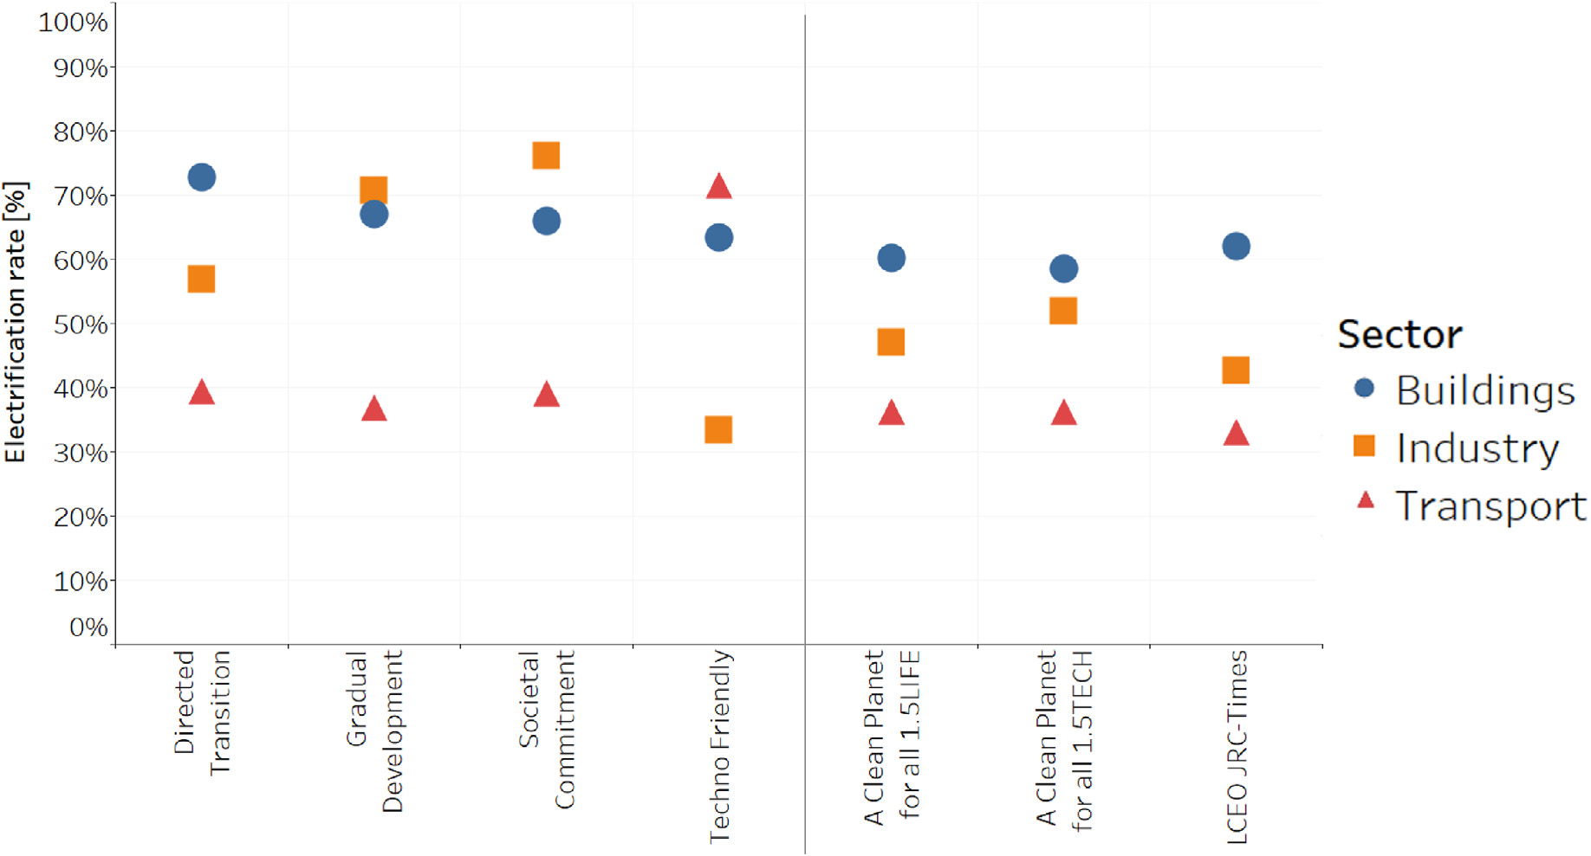
Electrification rate of the different sectors in 2050 at EU27 level according to assessed pathways and scenarios.

Slide 9
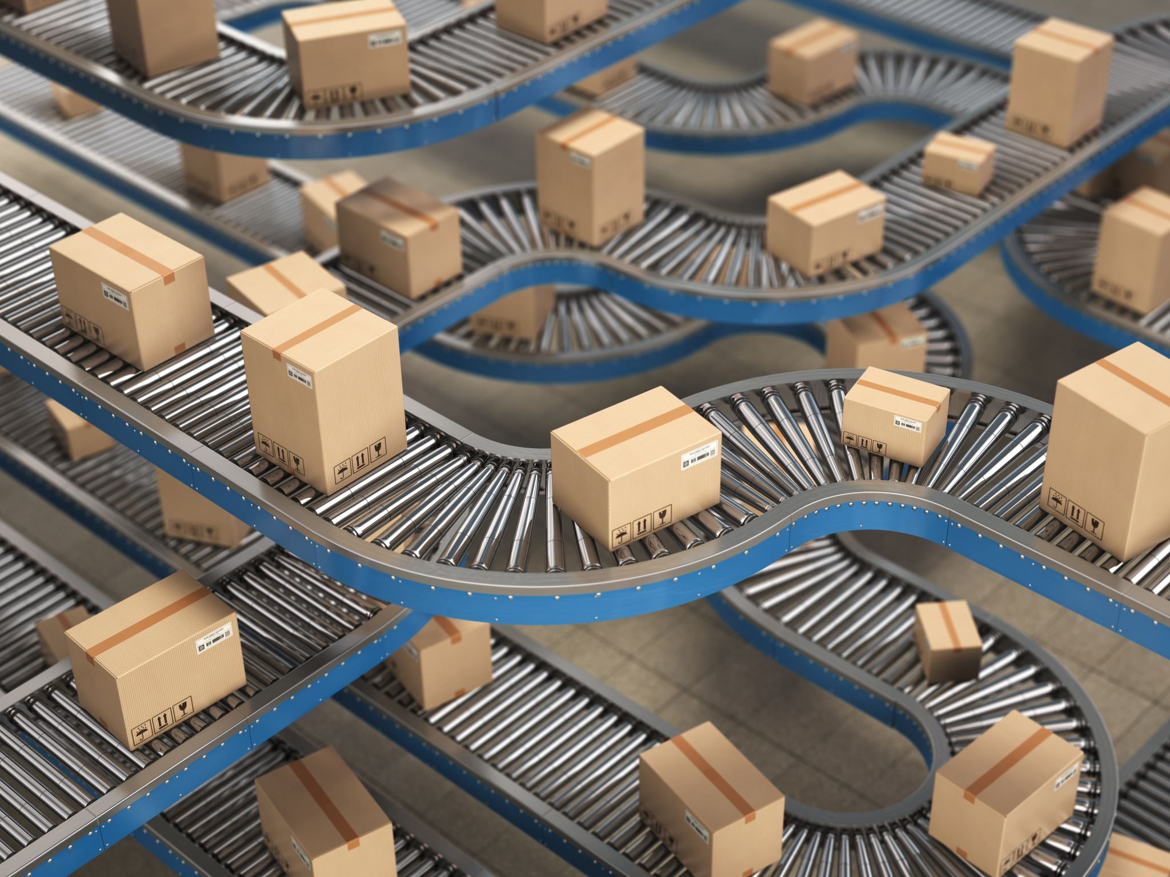
The openENTRANCE pathways demonstrate the usefulness of coherent input assumptions in energy system modeling, and their results are compared with other studies focused on high decarbonization, providing opportunities for further analysis of common findings and policy recommendations.
Electrification rates vary across pathways, with Techno Friendly having lowest in industry and highest in transport, buildings and transport have consistent rates, and openENTRANCE pathways have higher rates in industry than other studies, with Societal Commitment having the highest rate due to factors such as technology unavailability and high carbon prices.

Slide 10
Comparison of cumulative installed capacities of power generation technologies by 2050 at EU27 level according to assessed pathways and scenarios.

Slide 11
Discussion and policy recommendation
All modelling requires a certain assumption and hence often produce varying results thus making policymaking a challenge.
With high amounts of renewables and the resulting shift in the overall system, the job landscape will change with a large number of new jobs being created.
The industry sector faces the challenge of decarbonizing difficult to electrify industry branches (e.g., the steel or cement industry).
The renovation rate of houses and their insulation is one of the best ways of reducing building energy consumption

Slide 12
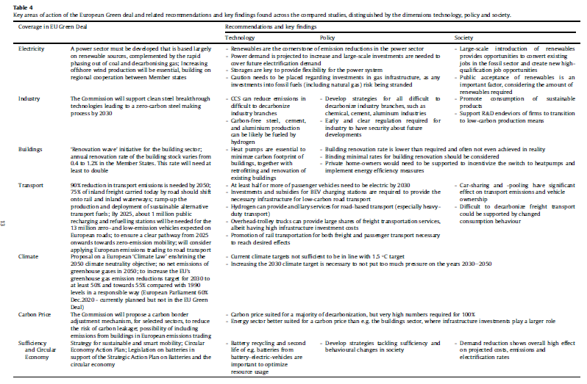

Slide 13
Conclusion
Overall, the EGD put in place many necessary plans in order to achieve the decarbonization of the European energy system, as illustrated by the scenario calculations of the openENTRANCE project but also many other institutions and projects.

Slide 14
Thank you! Questions?
r.sabyrbekov@osce-academy.net

