Slide 1
EU global leadership in climate policy
Rahat Sabyrbekov
OSCE Academy
Bishkek 2023

Slide 2
The European Union’s international climate leadership: towards a grand climate strategy?, Journal of European Public
Sebastian Oberthür & Claire Dupont (2021)

Slide 3
Introduction
The EU has pursued international climate change leadership since the early 1990s
Despite challenges, the EU has exerted leadership in various climate agreements
An up-to-date, comprehensive assessment of EU climate leadership is needed

Slide 4
Assessment Framework
The framework distinguishes between exemplary and diplomatic leadership
Both domestic and external dimensions of EU leadership are considered
Evolving framework conditions are taken into account

Slide 5
EU Climate Leadership Analysis
The EU has adapted its climate diplomacy to evolving challenges
Domestic policies and politics have contributed to EU leadership
The European Green Deal launched in 2019 represents a post-Paris development

Slide 6
The EU’s International Climate Leadership: Assessment Framework
To qualify as a ‘leader’ in global climate governance, an actor must pursue ambitious policy objectives towards multilaterally agreed climate goals.
Leadership can be distinguished from its effectiveness, which is an empirical question.
The appraisal of the EU’s international climate leadership focuses on whether and to what extent the EU has mobilized its climate leadership capabilities.

Slide 7
EU Leadership and Its Appraisal
Neither international policy outputs nor outcomes/impacts are useful/appropriate yardsticks to appraise EU leadership.
Goal achievement is similarly unsuitable because other variables intervene between the EU’s actions and the outcome of negotiations.
To appraise the EU’s international climate leadership, the focus is on investigating the adequacy of the EU’s own input into and contribution to international climate policy.

Slide 8
Framework Conditions
Investigating framework conditions can constitute challenges to the EU’s international approach and may require adapting this approach for maximum international impact.
The EU’s legal-institutional set-up significantly shapes and conditions EU leadership.
Investigating EU domestic climate politics drives ‘exemplary leadership’ but does not directly affect the EU’s international approach.

Slide 9
Exemplary and Diplomatic Leadership
Leadership types can be grouped into two broad categories: exemplary and diplomatic leadership
Exemplary leadership is based on domestic policy action and includes target-setting and legislative frameworks, resulting GHG emissions, and international credibility
Diplomatic leadership combines structural, cognitive, and entrepreneurial leadership and aims to coerce, convince, and cajole other parties into action
Exemplary and diplomatic leadership are interrelated and interact, and their integrated use can maximize influence

Slide 10
Exemplary Leadership
Exemplary leadership provides three means of international influence: underpins international credibility, inspires other actors through policy learning and diffusion, and materially incentivizes other actors to adapt
Domestic policy is a significant means of international influence and includes market and regulatory power
Exemplary leadership is derived from domestic policy action and incorporates aspects of ideal-typical structural leadership

Slide 11
Diplomatic Leadership
Diplomatic leadership is premised on coherence and unity among EU member states and how well the EU coordinates for coherence and unity
Diplomatic leadership involves mobilizing structural, cognitive, and entrepreneurial capabilities, including diplomatic contacts, outreach, and finance, to fit the prevailing international context
To assess diplomatic leadership, we should investigate the extent to which the EU has effectively coordinated for coherence/unity and deployed its capabilities to fit the international context
The integrated use of exemplary and diplomatic leadership can maximize the EU's influence in international climate leadership.

Slide 12
The EU’s international policy goals, goal achievement, and resulting outcomes
EU has pursued the most ambitious science-based international climate policy objectives of the major economies
EU has consistently advocated for binding mitigation obligations for developed countries
EU achieved its international leadership objectives from the 1990s, crashed in Copenhagen in 2009, and recovered modestly in the 2010s

Slide 13
Framework conditions are met?
International context captures core elements of the climate-related ‘geopolitical shifts’
Domestic legal-institutional framework concerns the EU’s ‘governance constraints’
National climate legislation has spread especially among larger emitters, but it has so far only resulted in tempering global emission growth rather than steep emission reduction

Slide 14
International climate politics and its institutional framework
International climate governance has become ‘polycentric’
Paris Agreement reflects the EU’s main, moderated policy objectives
Effective mechanisms for coordination of EU external climate policy are needed to align both EU institutions and its member states.

Slide 15
Exemplary Leadership
EU has made significant progress in domestic climate policy.
This progress has enhanced its international credibility.
Despite significant internal turbulence and external pressure, the EU has consistently pursued ambitious emission reduction targets.

Slide 16
EU Climate Policy Framework
The EU has developed a robust climate policy framework.
Decadal frameworks for climate and energy policy have been implemented.
The framework includes several key implementing legislations, addressing various sources of emissions, such as cars and fluorinated GHGs.

Slide 17
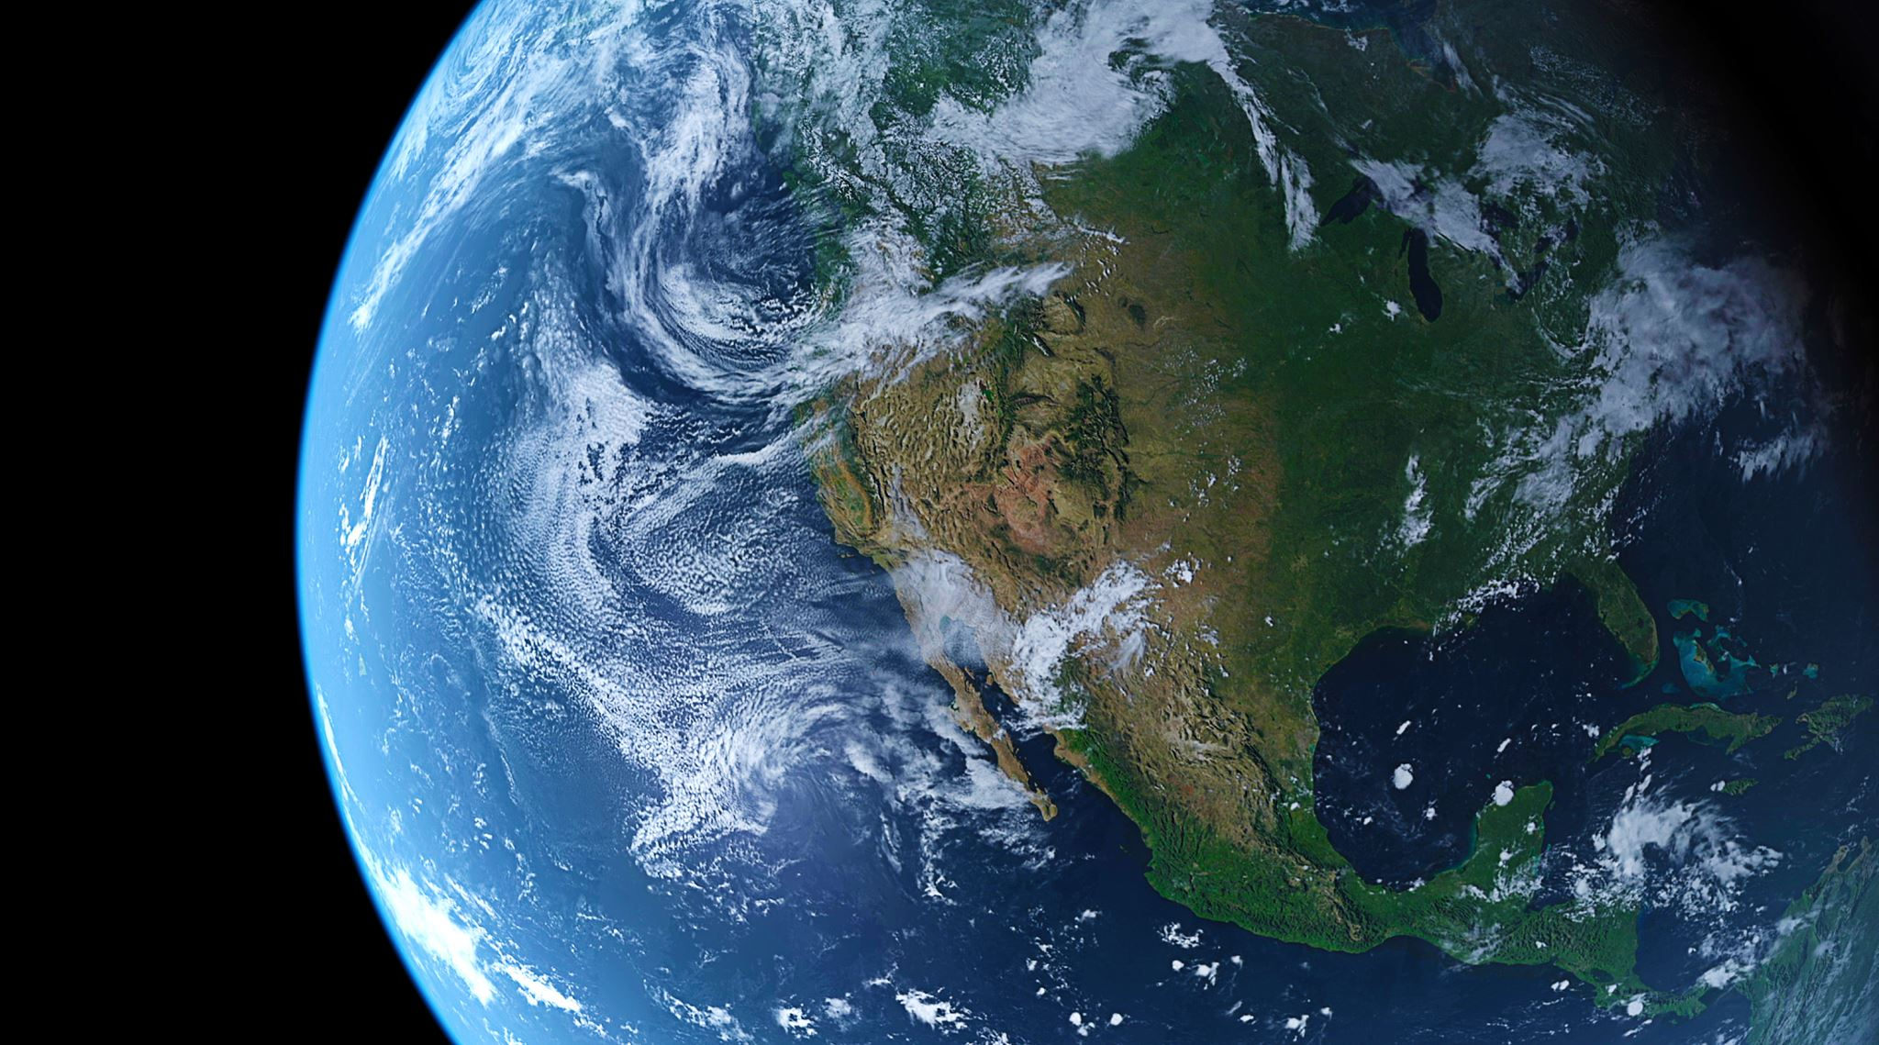
Achievements of EU Climate Policy
The EU has met or exceeded its domestic mitigation targets so far.
The EU is on track to exceed its 20% emission reduction target for 2020.
The EU is not on track to meet its emission targets for 2030 and 2050, requiring considerable additional efforts.

Slide 18
European Green Deal
The European Green Deal, launched in 2019, promises additional efforts to meet 2030 and 2050 emission reduction targets.
The Green Deal foresees a suite of proposals for implementing legislation, prioritizing climate policy objectives across all EU policy fields.
The Green Deal includes a Just Transition Mechanism and Fund to support sectors dependent on fossil fuels or carbon-intensive processes.

Slide 19
EU's Global Influence
EU climate policies have become a benchmark and a source of inspiration for others.
The expansion of the EU’s climate policy portfolio has enhanced the potential for policy diffusion.
Climate policy has become essential in shaping access to the European market and building the regulatory and technological capacity to address climate change.

Slide 20
Discussion and Conclusions
Approach used to systematically assess the EU's leadership record on climate change.
The EU has achieved important results in mobilizing its capacities and adapting to external conditions over the past decades.
The EU has significantly adapted its international approach to the evolving turbulent context, including the rise of emerging powers and growing polycentricity.

Slide 21
Key Challenges for EU Climate Leadership
Maintaining and expanding achievements in coordination of climate diplomacy across foreign and climate policy.
Advancing effective 'polycentric' engagement beyond the UN process.
Developing a more strategic approach that emerged in the 2010s into a full-fledged joint grand climate strategy

Slide 22
Facilitating EU Grand Climate Strategy
The EU lacks a strategic center capable of coordinating a grand strategy at the highest political level.
A new body of high-level climate ambassadors or 'czars' could advance discussions on grand climate strategy and facilitate maintenance and further development of existing achievements.
Even if full strategic convergence may remain illusory, creating related structures and capacities could facilitate joint strategizing.

Slide 23
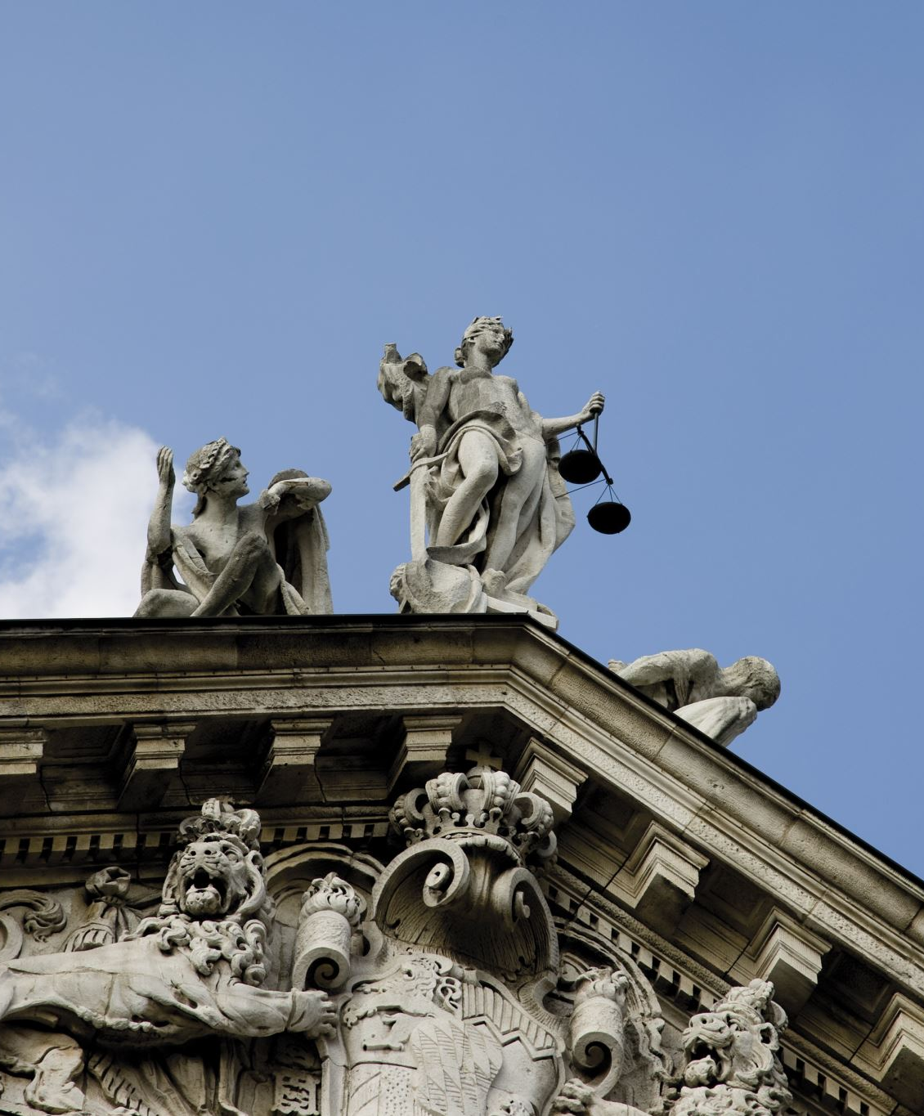
EU and Paris agreement
https://www.youtube.com/watch?v=s-jJIupxF_A
EU example: https://www.youtube.com/watch?v=pUbHGI-kHsU

Slide 24
Thank you! Questions?
r.sabyrbekov@osce-academy.net

