Slide 1
Presentation to the Board of Trustees
Vienna, 5 June 2018

Slide 2
Current Financial Situation | Audit 2017
Audit first time conducted by Deloitte Kyrgyzstan
Approved of expenses and provided commentary on
Risk Management
Control Mechanism
Governance System
Programme Office in Bishkek plans to extend the contract with Deloitte to secure highest Auditing Standards in the coming years

Slide 3
Current Financial Situation | Implementing Budget for 2018

Slide 4
Current Financial Situation | Implementing Budget for 2018
Unified Budget
Until 2017 funding was 247,000 EUR
As of 2018 funding has been increased to 317,000 EUR
ExB Project
Envisages funding in amount of 429,948 EUR in 2018
Secured with generous contributions from Austria, Finland, Switzerland, and United States
Third-Party Funding
NUPI contributes 465,213 EUR in 2018 (including re-allocation from 2017 this amounts to 548,386 EUR)
Switzerland adds ~33,500 EUR (40,000CHF)
Funding for 2018 amounts to 1,245,661 EUR (not including NUPI re-allocation)
No funding for Journalism School (~50,000 EUR)
Visiting Faculty externally funded (OSCE missions, DAAD, Erasmus+)

Slide 5
Request for ExB Funding for Years 2019-2020
ExB Project envisages funding for Students, Academics, Meritocracy, Alumni in 2019 and 2020 in the amount of:
2019: 575,315 EUR
Increase in 2019 due to additional support to Academics
2020: 716,846 EUR
Increase in 2020 due to additional support to Students (back-up for possible end of NUPI support)
ExB funding for 2019 secured in the amount of 139,800 EUR
Request for Funding in 2019 in the amount of 435,515 EUR
ExB funding for 2020 secured in the amount of 139,800 EUR
Request for Funding in 2020 in the amount of 577,046 EUR

Slide 6
Funding Strategy for 2019 and Beyond
Strategic Goal: Diversification of Funding Sources plus Multiplication of Educational Partnerships
Development of new Educational Programmes with separate applications (Erasmus+; UN; DAAD; Client II)
New Partnerships to develop Professional Trainings and Academic Workshops as well as - ECTS compatible – Modules (e.g. Summer School with Viadrina University, Journalism Trainings with IWPR)
Attracting more OSCE pS as donors to (future) possible ExB projects
Strengthening Partnership with NUPI with new cooperation project after 2019
Increasing external funding to Visiting Scholars (e.g. via DAAD or Erasmus+; bilateral agreements)

Slide 7
Reforming the Academy
Structural Adjustments in 2017; OIO recommendations from 2017; Audit in 2018; internal review since Fall 2017 – have revealed need to continue structural reforms and to implement operational innovations in the administration of the OSCE Academy:
Documentation & Archive: Creating a complex institutional memory
Hiring & Contracting: Developing a unified HR system
Budgeting and Accounting Regulations: Simplifying budgeting procedures; Using C1 accounting software
Mid-Term: Reviewing /Updating the Charter of the OSCE Academy

Slide 8
Developing Educational Programmes
Graduation and Admission in 2017/2018:
In December 2017, 26 students of the MA programme in Politics and Security, and 26 students of the MA programme in Economic Governance and Development graduated and received their certificates
Whereas the Academy received 1,043 applications in 2017, and subsequently enrolled 48 students for the 2017-2018 academic year, 2,114 applications were submitted in the spring of 2018 for the academic year 2018-2019

Slide 9
Developing Educational Programmes
Country | 2017-2018 Final
 | EGD | PS | Total
Kazakhstan | 14 | 30 | 44
Kyrgyzstan | 139 | 166 | 305
Tajikistan | 46 | 39 | 85
Turkmenistan | 2 | 1 | 3
Uzbekistan | 13 | 12 | 25
Afghanistan | 345 | 220 | 565
Mongolia | 3 | 3 | 6
Out of region | 1 | 9 | 10
SUBMITTED | 563 | 480 | 1043
Country | 2018-2019 Final
 | EGD | PS | Total
Kazakhstan | 44 | 56 | 100
Kyrgyzstan | 187 | 249 | 436
Tajikistan | 141 | 111 | 252
Turkmenistan | 2 | 6 | 8
Uzbekistan | 36 | 37 | 73
Afghanistan | 717 | 454 | 1171
Mongolia | 10 | 8 | 18
Out of region | 23 | 33 | 56
SUBMITTED | 1160 | 954 | 2114

Slide 10
Developing Educational Programmes
Licensing and Accreditation
In 2017 received five-year accreditation for EGD programme by independent accreditation agency EdNet
UPDATE: In June 2018 successfully received accreditation for revised P&S programme curriculum for the period of five years
Both programmes today have unlimited license from the Kyrgyz Ministry of Education for their educational operations.
Strengthening Faculty at the Academy
Creation of full-time faculty positions (using support from Switzerland, NUPI, DAAD)
Establishing Chairs for both programmes responsible for Academic Development
Establishing new rules for hiring Visiting Lecturers: Educational Partnerships / Competitive Hiring
Resuming regular faculty meetings / Creation of Advisory Board

Slide 11
Developing Educational Programmes|Internships
Several new cooperation agreements have been signed providing for new international Internship positions:
European Centre for Minority Issues in Flensburg (up to 3 positions)
Geneva Institute for Security Policy in Geneva (1 position)
Aleksanteri Institute in Helsinki (1 position)
In preparation are:
German Development Institute in Bonn (up to 2 positions)
Austrian Study Centre for Peace and Conflict Resolution in Stadtschlaining (up to 3 positions)
German Institute for International and Security Affairs in Berlin (up to 2 positions)
Confirmed Partnerships with:
OSCE Secretariat in Vienna (up to 6 positions)
OSCE HCNM in The Hague (1 position)
NUPI in Oslo (up to 4 positions)

Slide 12
Developing Educational Programmes
Establishing Educational Partnerships
Viadrina University (DAAD Summer School in July 2018)
ECMI (Module on European Politics / Minorities in June 2018)
NUPSPA (Application to Erasmus+ (Key Action 1) in February 2018
UNAMA (Planned Module on UN in Fall 2018)
Initiating new Educational Programmes
Creating a Third MA programme (Law; MBA; Public Policy/Peace Studies/HR)
Establishing a PhD programme in Security Studies (Erasmus+ Consortium)
Preparatory Courses / Summer School in August for admitted students, reserve list, graduates from Kyrgyzstan
Pilot Programme in August 2018

Slide 13
Developing Research and Dialogue
(Senior) Lecturers to promote Research at the Academy
Two regional scholars with reduced teaching load and the explicit task to develop research programmes and implement research projects (First Senior Lecturer started his work on 1 June 2018; second expected to start in 1 July)
Research Methods Training Series
New focus on imparting of knowledge on methods in the social sciences & the humanities (Pilot Workshop in July 2018)
Associate Research Fellowships
Academy as place to conduct research / organize field studies in Central Asia (3 Associate Research Fellows since December 2017)
New Conference Format and Proceedings
Thematic focus in Security Conferences; Academy Paper Series (New Conference on Non-Traditional Risks in May 2018)
New Speakers‘ Series
Critical Readings Lectures Series; Alumni Talk (both programmes scheduled for Fall 2018)

Slide 14
Developing Research and Dialogue|Publications

Slide 15
Professional Trainings
Certificate Programmes
Certificate Programme on Human Rights, Conflict Sensitivity and Project Management & Policy Paper Writing Seminar
CP 2017: 14; PPWS 2017: 12; PPWS 2018:12 (CP 2018 – in June)
Feasibility Studies Programme
Regulatory Impact Analysis & Feasibility Studies for Investment Projects
RIA 2017: 13; RIA 2018: 21; FS 2017: 28; FS 2018: 19
Journalism Training with IWPR
Investigative and Analytical Journalism IWPR/OSCE Academy Workshop & Policy Brief Writing IWPR/OSCE Academy Workshop
IAJ 2018 – in June; PBW 2018 – in July
Plans for Advanced Training Programme
Pilot Programme - Masterclass: Interviews as Method in the Social Sciences & Humanities
MC 2018 – in July

Slide 16
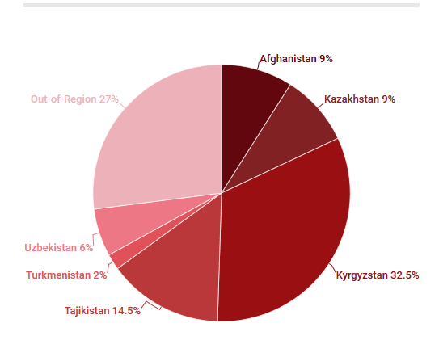
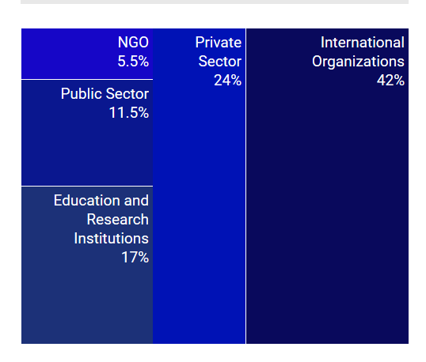
Alumni Affairs
Statistics of Academy Alumni | numbering 427
Geography of Residence Employment by Sectors
(Currently 26 Alumni are pursuing PhD!)

Slide 17
Alumni Affairs
New Thematic Workshops / Chapter Meetings
Alumni Workshop on Gender Issues (Feb 2018)
Chapter Meeting in Dushanbe (Apr 2018)
Chapter Meeting in Kabul (May 2018)
Academy Alumni Meeting in Vienna (June 2018)
Travel Grants
Assel Mussagaliyeva '05 PS for attending “Sustain and Retain: The Place of Sustainability within Conservation”, Workshop at Cambridge University | March 2018.
Aigerim Almazova '17 EGD for travel to Geneva to begin her internship at WTO Headquarters | March 2018
Alumni Conference (planned Oct 2018)

Slide 18
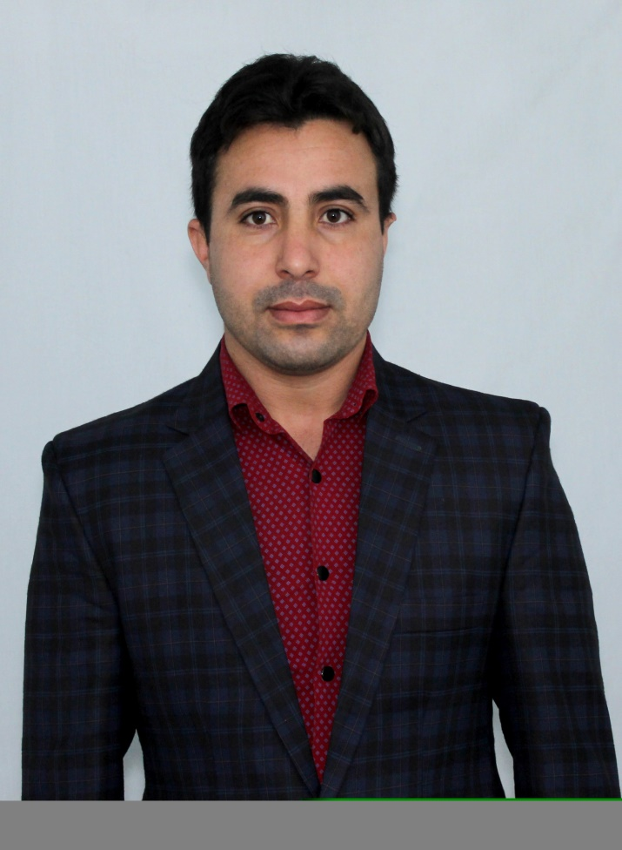
Alumni Affairs|Success Stories
Rahimulla Kakar ’16 PS
In June 2017 Rahimulla started working at the Policy and Analysis Department at the Administrative Office of the President of Afghanistan. In March 2018 he was promoted to a Head of Relations and Documents Unit at the Administrative Office of the President of Afghanistan

Slide 19
Alumni Affairs|Success Stories
Sevilya Murodova ’08 PS, currently is a PhD Candidate at Ankara University, Graduate School of Social Science

Slide 20
Alumni Affairs| Success Stories
Meerim Topchubaeva ‘15 EGD
Since 2016 Meerim is doing a PhD in Business Administration at Central European University (expected in June 2020). After graduation of the OSCE Academy, she worked as a Programme Assistant at the Agency for Technical Cooperation and Development in Osh, Kyrgyzstan. She was able to organize and receive the license for the «TEDxOsh: Opportunities». She also taught Microeconomics and Macroeconomics to Business Administration BA students at the American University of Central Asia in Bishkek.

